Slide 1
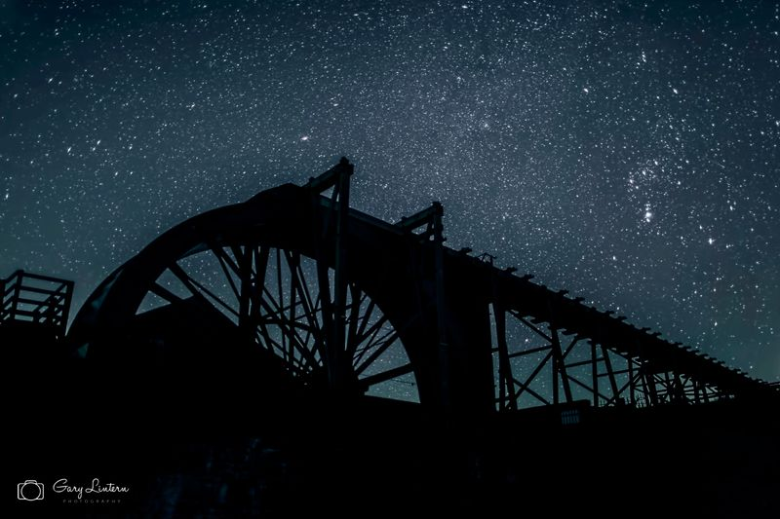
North Pennines Stargazing Festivals
Shane Harris: Responsible Tourism Lead
North Pennines AONB Partnership
Notes:
This page should stay the same for every presentation – the others in the document are for guidance only. However, the purple keyline must remain on all pages. Font should be from the Barmeno family. White on purple on this page.

Slide 2
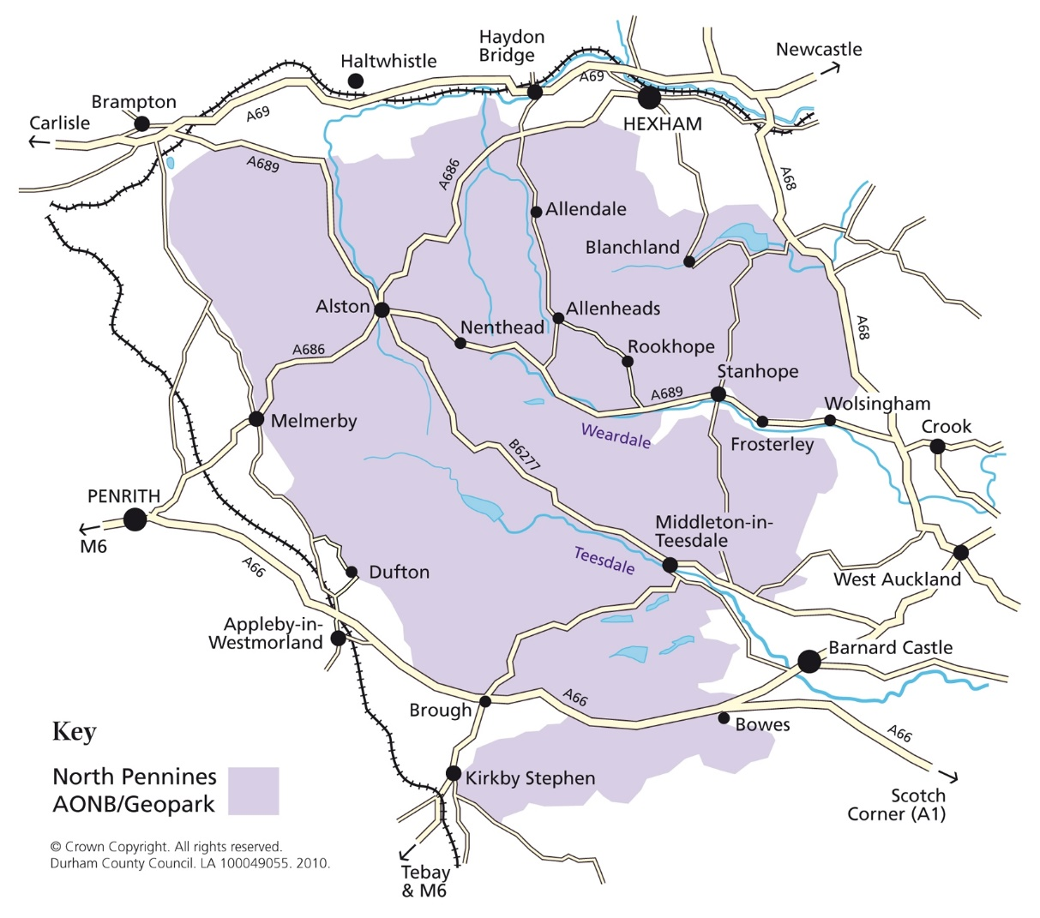
Where is the North Pennines?
2nd largest of the 46 AONBs
Almost 2,000 km²
Western County Durham
Stretching over into Cumbria and Northumberland
Notes:
Font – Barmeno family

Slide 3
What’s the offer?
Inky-black night skies
Darkest mainland Area of Outstanding Natural Beauty, 86% pristine skies
1,000s of stars visible compared to 10s in a light-polluted urban area
Aspirant International Dark Sky Reserve
First Stargazing Festival – 2017
2022 will be the 6th edition
Notes:
Font – Barmeno family

Slide 4
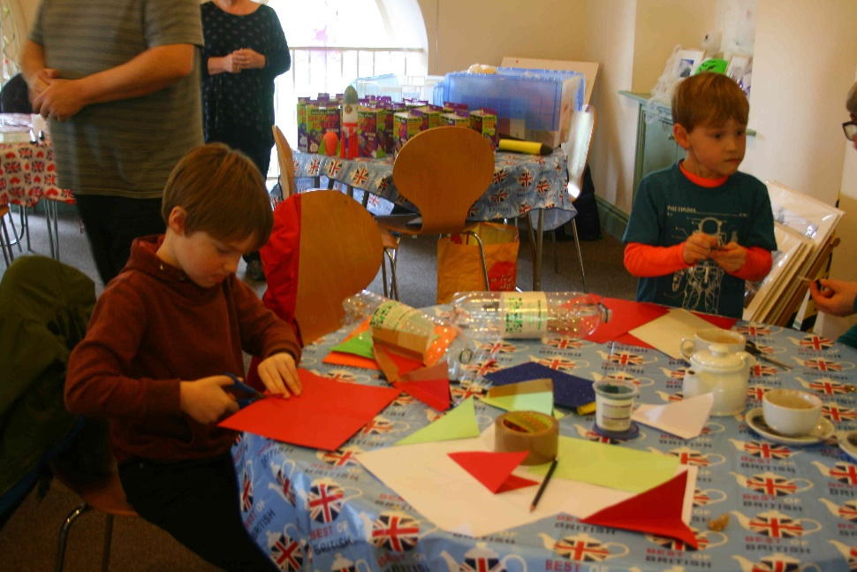
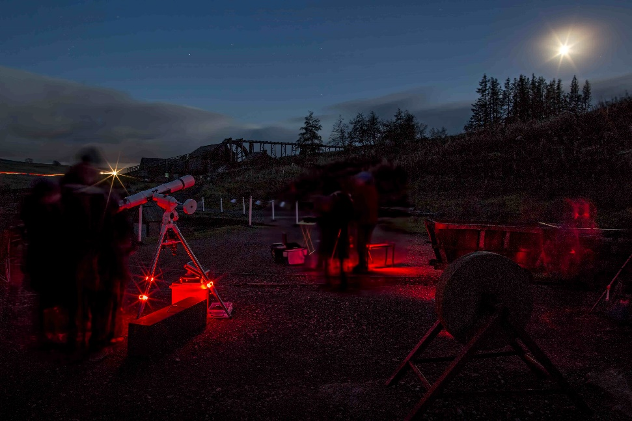
Brief History
October Half Term - since 2017
2017: 13 events across the North Pennines:
755 attended
18% overnights
2018: 30 events over 2 weeks
1,512 attended events – fully booked (97%)
25% overnights
Economic impact - £119,000
RoI £1 : £8.5
2019: 29 events over a week
1,241 attendance – 43% families
27% overnights
Economic impact £120,000
RoI £1 : £21
Notes:
Font – Barmeno family

Slide 5
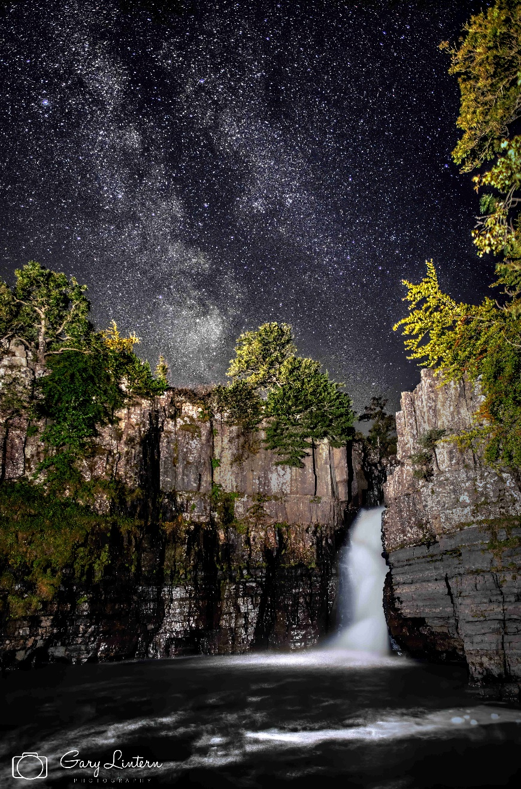
North Pennines Star Gazing Festival
2020: Stargazing Week
The pandemic didn’t stop us!
Online activity, October Half Term
2021: 25 events across the North Pennines:
1,072 attendees
Return of Star Camp at Doe Park Caravan Site
10 events at Grassholme Observatory
High Force & Raby Castle Stargazing with Star Safaris
Dark Skies Run
Skywatch at Talkin Tarn & Alston Moor Golf Club
Daily Stargazing Tips & Nocturnal Animal Tips – across social media channels
Pies ‘n’ Skies – The Hive
Notes:
Font – Barmeno family

Slide 6
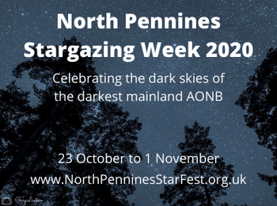
Stargazing Festivals - Aims
Stargazing activity in October Half Term
Highlighting how special the dark night skies are in the North Pennines
Widening content to embrace nocturnal animals
Encouraging #backyardstargazing
Helping people to understand what they can do to protect dark night skies
Opportunities for live stargazing
Notes:
Font – Barmeno family

Slide 7
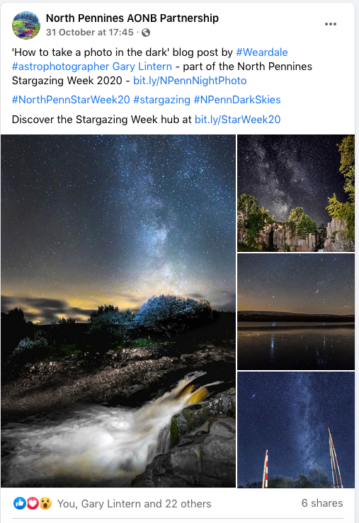
How to guides
Encouraging budding astronomers to get involved in #backyardstargazing
Richard Darn’s Star Tips of the day
10 daily posts
Practical guidance
What can you see tonight
How to take a photo in the dark? blog
What can you see in the night sky? blog
Notes:
Font – Barmeno family

Slide 8
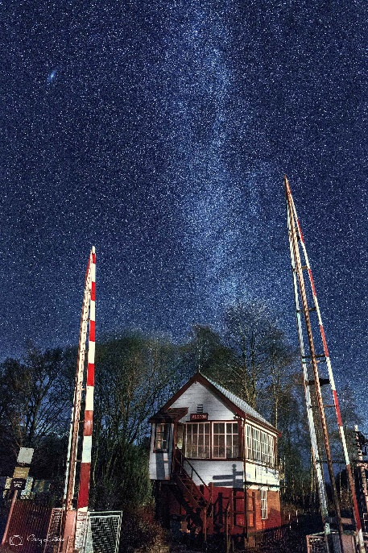
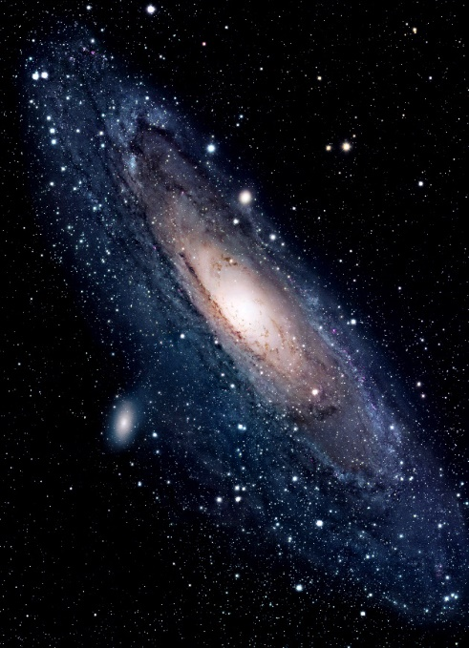
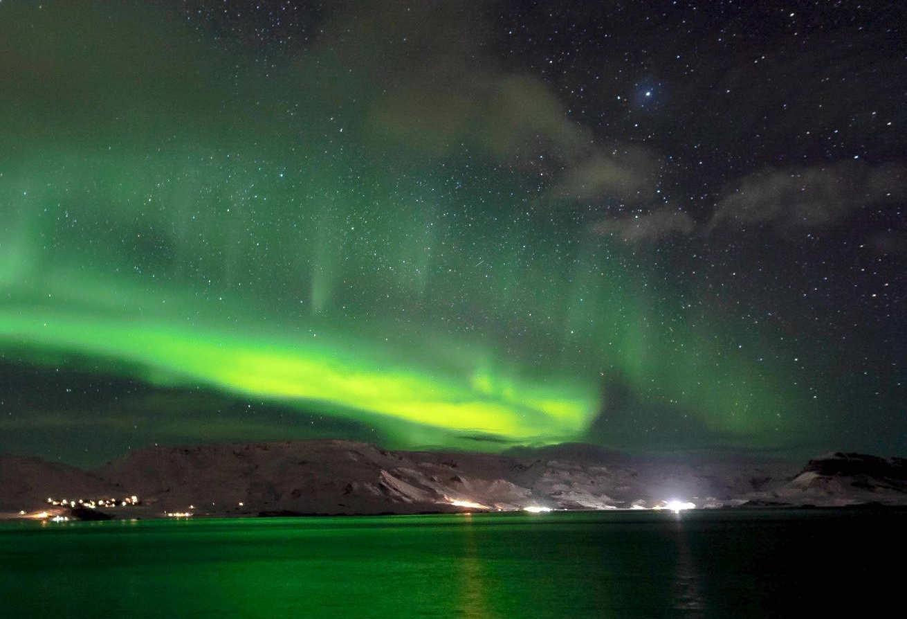
Virtual events
Via Zoom
116 attendance
“Please pass on my thanks for an absolutely fascinating Zoom talk tonight by a really professional presenter. Some of the facts he gave were staggering!”
“Thanks very much for these - loved the presentation you and Andy organised. I hope the weather improves over the hills of Frosterley so I can have a decent look for Andromeda. Fingers crossed next year's event can be in person.”
Notes:
Font – Barmeno family

Slide 9
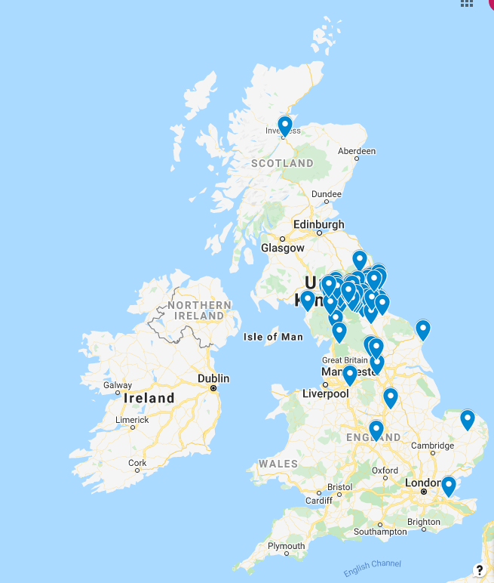
Map of AONB’s in the UK
Notes:
Font – Barmeno family

Slide 10
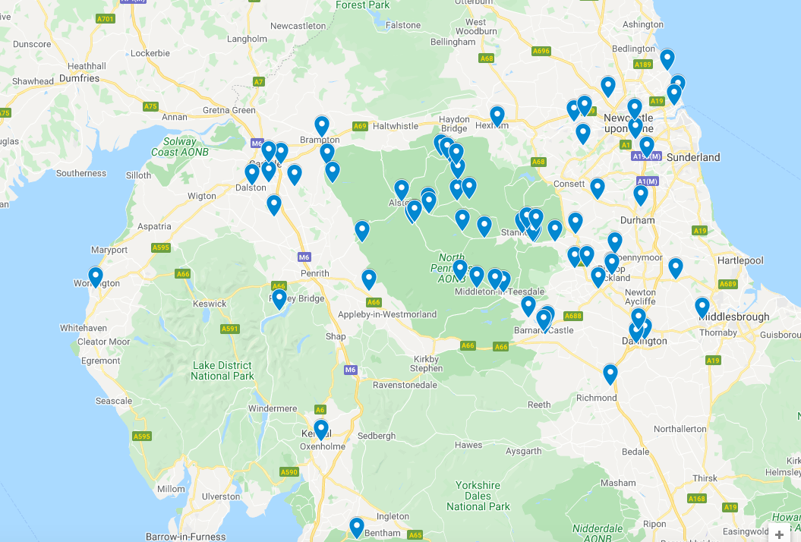
Dark Sky Discovery Sites in the North of England
Notes:
Font – Barmeno family

Slide 11
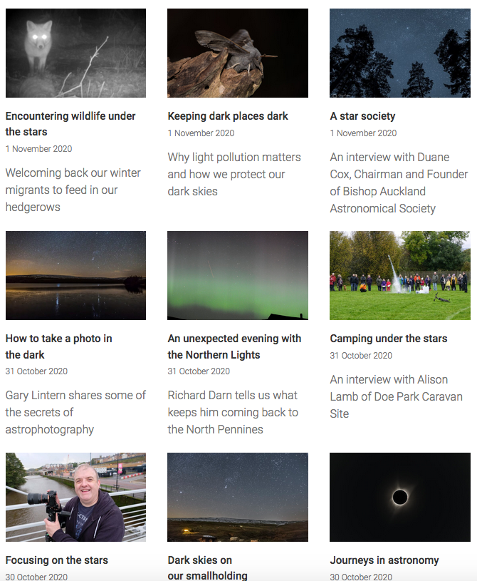
Blog posts
24 blog posts over the week
All available at the Stargazing Week hub page: http://bit.ly/StarWeek20
15 different authors
Wide-ranging stargazing, space, dark skies topics:
Andromeda
Northern Lights
Astrophotography
Interviews with local astronomers and businesses
Each blog post had accompanying social media posts
Notes:
Font – Barmeno family

Slide 12
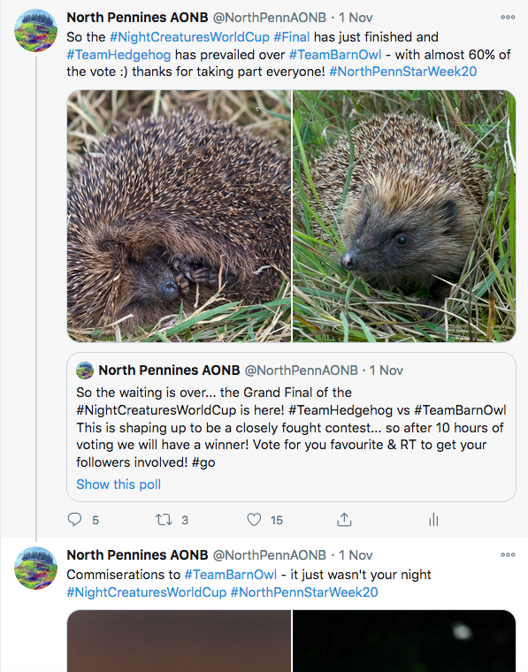
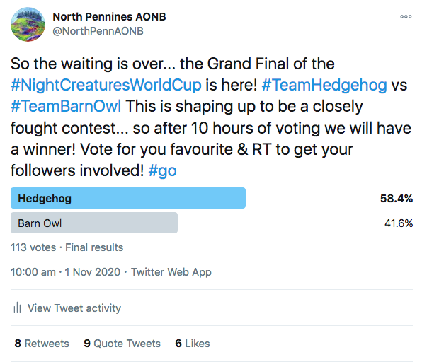
Nocturnal wildlife
Blog content
Things that go screech in the night
Camera trap footage from Fellfoot Forward
Night Creatures Twitter World Cup
Notes:
Font – Barmeno family

Slide 13
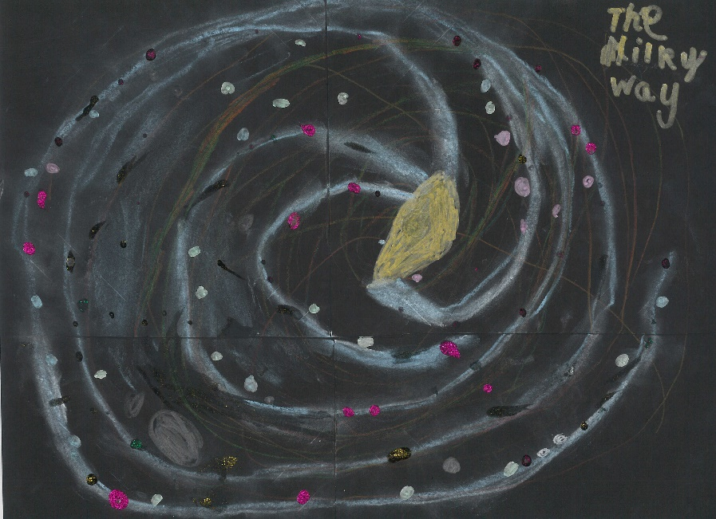
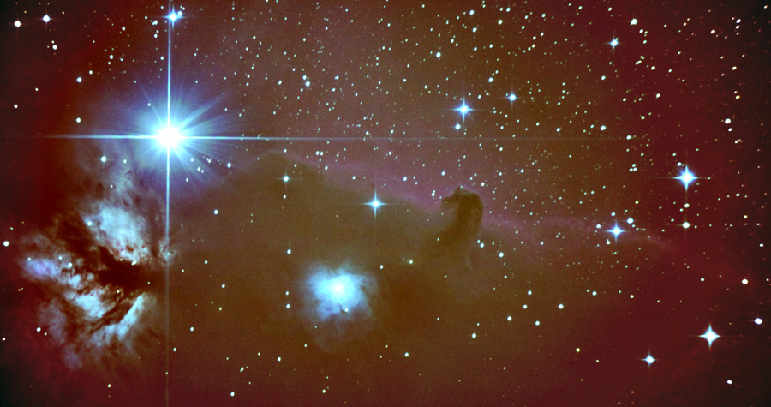
Star Art 2020
Children’s art competition
Launched during the festival
Three age groups:
Under 8s
8-12
13-18
32 entries
Extended impact beyond Half Term
Notes:
Font – Barmeno family

Slide 14
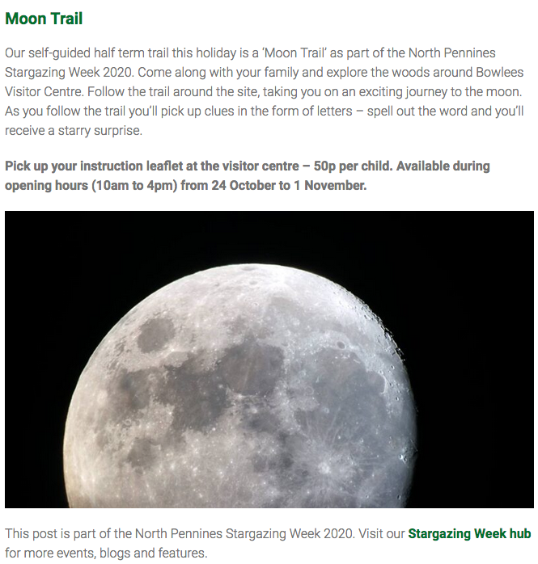
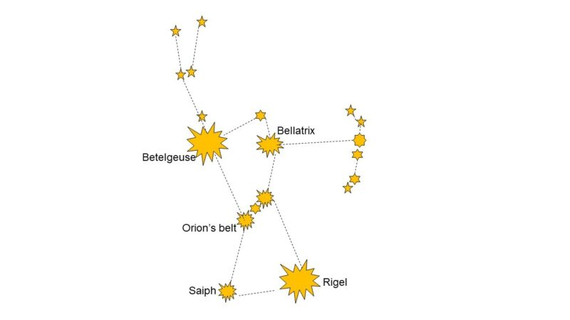
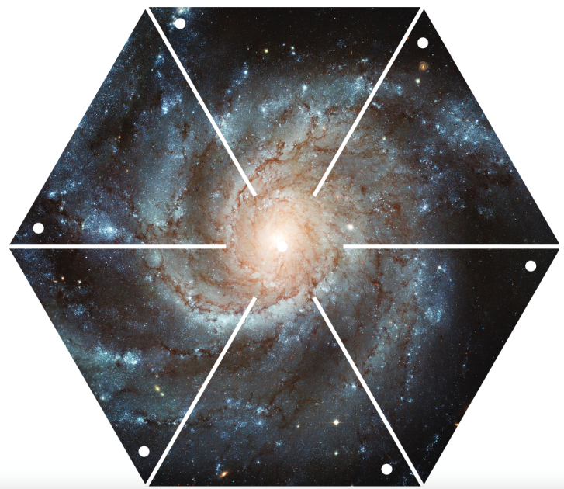
Bowlees Visitor Centre
Self-guided Moon ‘Treasure’ Trail – all week. Solar System theme in 2021
Wild Wednesday activities:
Nocturnal Animals
Make a pinwheel galaxy
Constellation game
Notes:
Font – Barmeno family

Slide 15
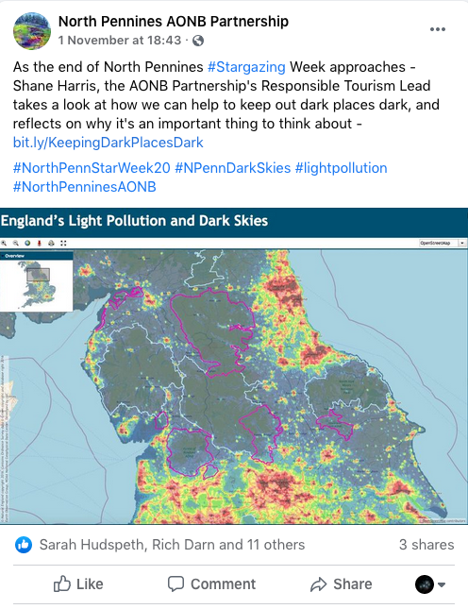
Spreading the word
How dark is it? Blog post
Setting out how special our dark night sky is and how important it is to preserve
Keeping dark places dark Blog post
Light pollution
Impacts – astronomy, human health, nature
How to tackle it
Facebook reach of almost 5,000 with over 300 engagements
150+ blog views
Notes:
Font – Barmeno family

Slide 16
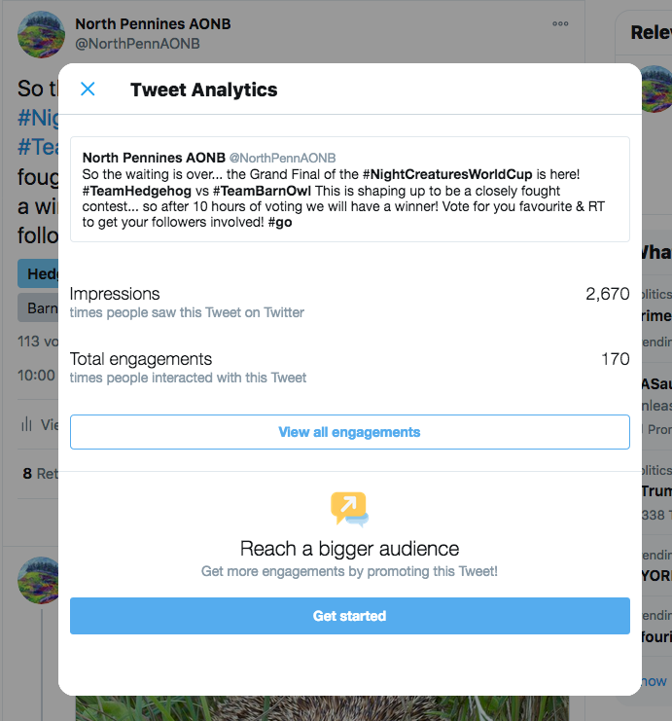
Impact (2020)
Facebook
Reach – 49,000
5,000+ engagements
Likes, comments, shares, image enlargements…
Launch post: 22,147 reach, 1,494 engagements, 76 shares
Twitter
235,000 tweet impressions
Bit.ly links
1,330 click throughs
Minimum figure, indicates click throughs from social media activity
Demonstrates the value of themed online content to drive engagement
Notes:
Font – Barmeno family

Slide 17
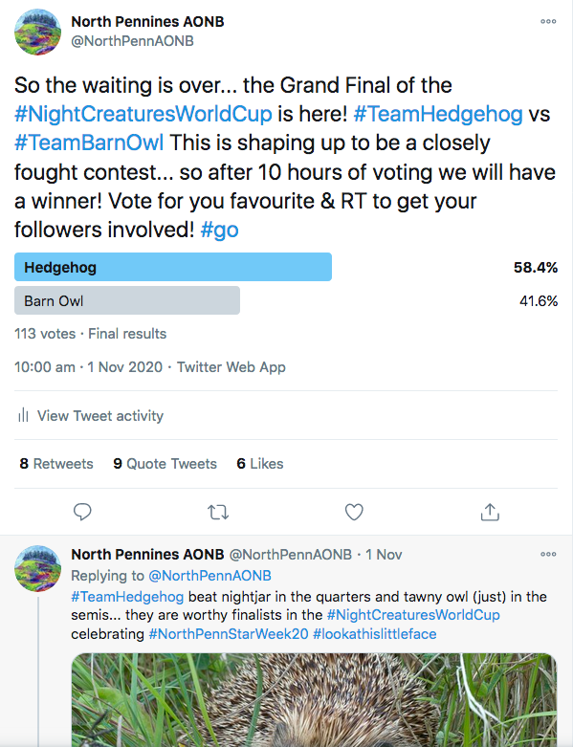
Impact
Night Creatures Twitter World Cup
932 votes
62 tweets
107,185 impressions (46% of total)
1,996 engagements, including:
78 #tag clicks
123 profile clicks
237 likes
129 re-tweets
63 replies
63 url clicks
211 media engagements
Fun = engagement
Notes:
Font – Barmeno family

Slide 18
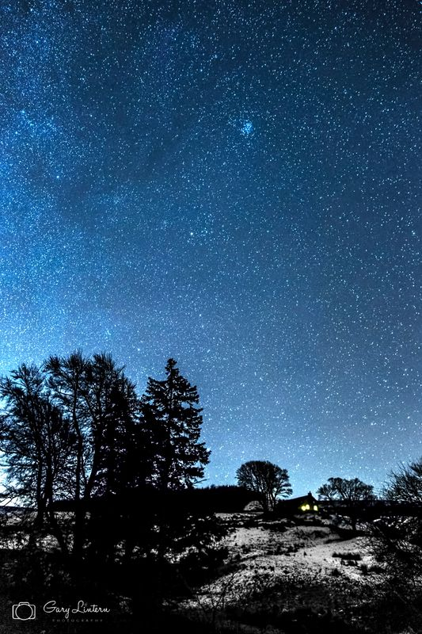
The future
What’s next?
6th North Pennines Stargazing Festival
October Half Term
21 to 30 October 2022
Programme finalised early July
Concluding thoughts
Only possible through collaboration
Great engagement
Evergreen content – all still available at http://bit.ly/StarWeek20
Notes:
Font – Barmeno family

Slide 19
Thank you
Thank you for listening…
Shane Harris BSc MSc MTMI
Responsible Tourism Lead
North Pennines AONB Partnership
shane@northpenninesaonb.org.uk
North Pennines AONB Partnership, Weardale Business Centre, The Old Co-op Building, 1 Martin Street, Stanhope, County Durham DL13 2UY
+44 (0)1388 528801
info@northpenninesaonb.org.uk www.northpennines.org.uk
Notes:
This page should always remain the same. Font – Barmeno family. White on purple on this page.

