Slide 1
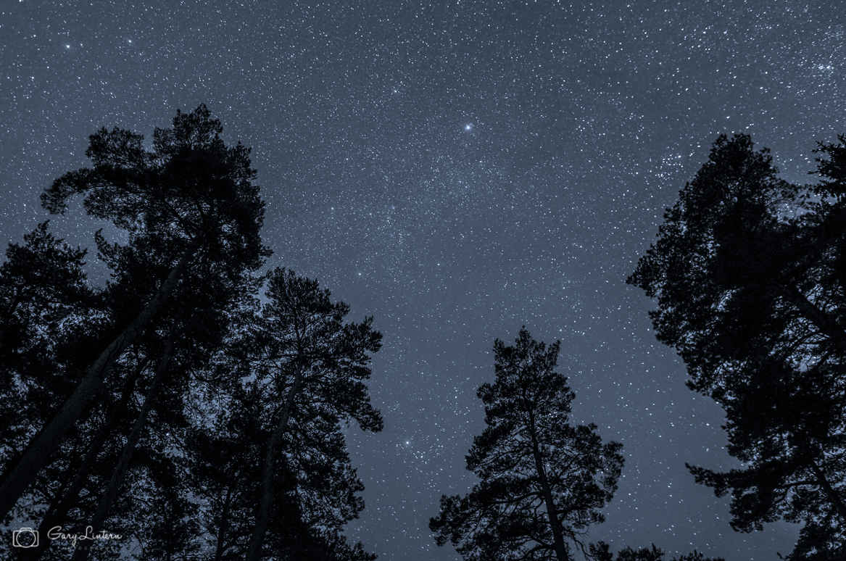
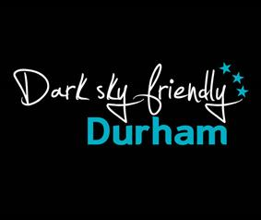
Astro Tourism
Richard Darn
@RichDarn1

Slide 2
Why do dark skies matter?
We waste £billions on light pollution
Approximately one third of UK wildlife is nocturnal
Reinforces sense of tranquillity
Positive impact on human health and well-being
80% UK residents live under light polluted skies
People hardly see any stars and can’t glimpse the Milky Way

Slide 3
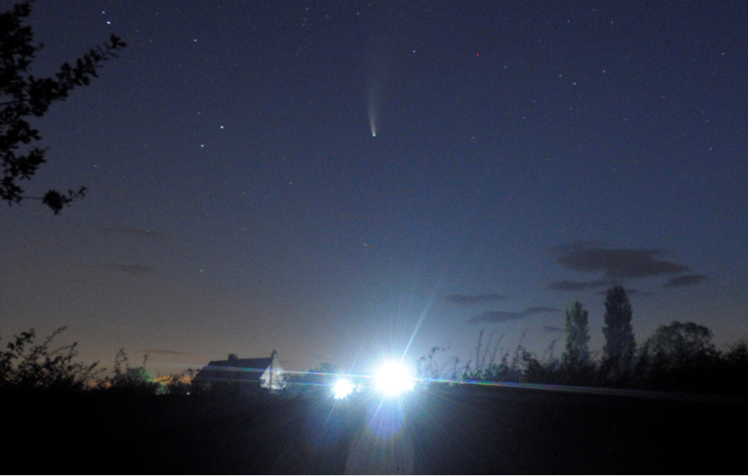
Why do dark skies matter 1?

Slide 4
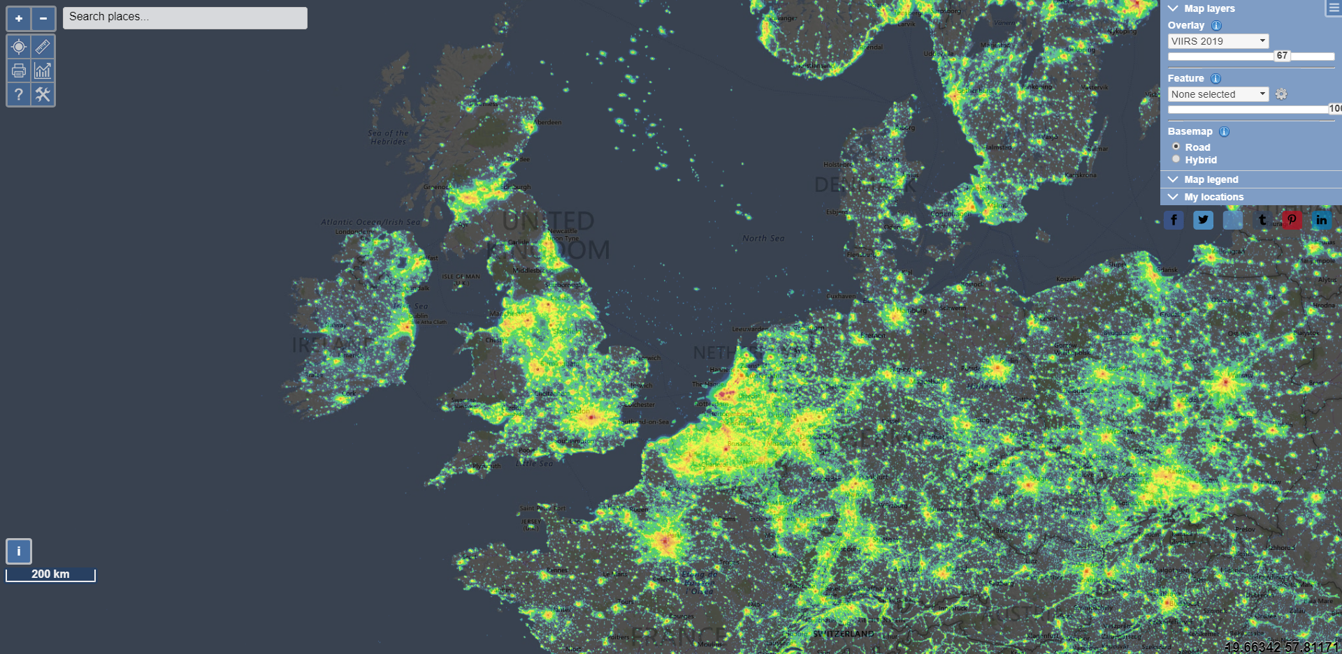
Light Pollution in Europe
www.lightpollutionmap.info

Slide 5
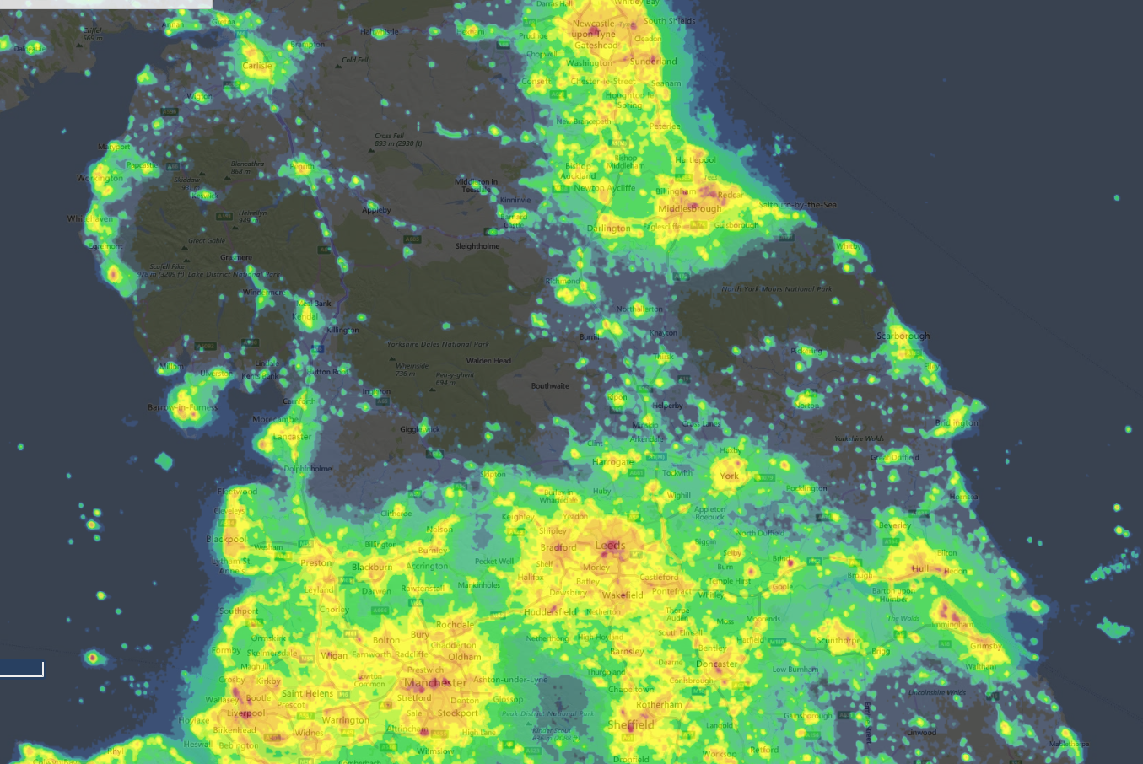
Light pollution in the North of England
www.lightpollutionmap.info

Slide 6
What does this mean
for the night sky?

Slide 7
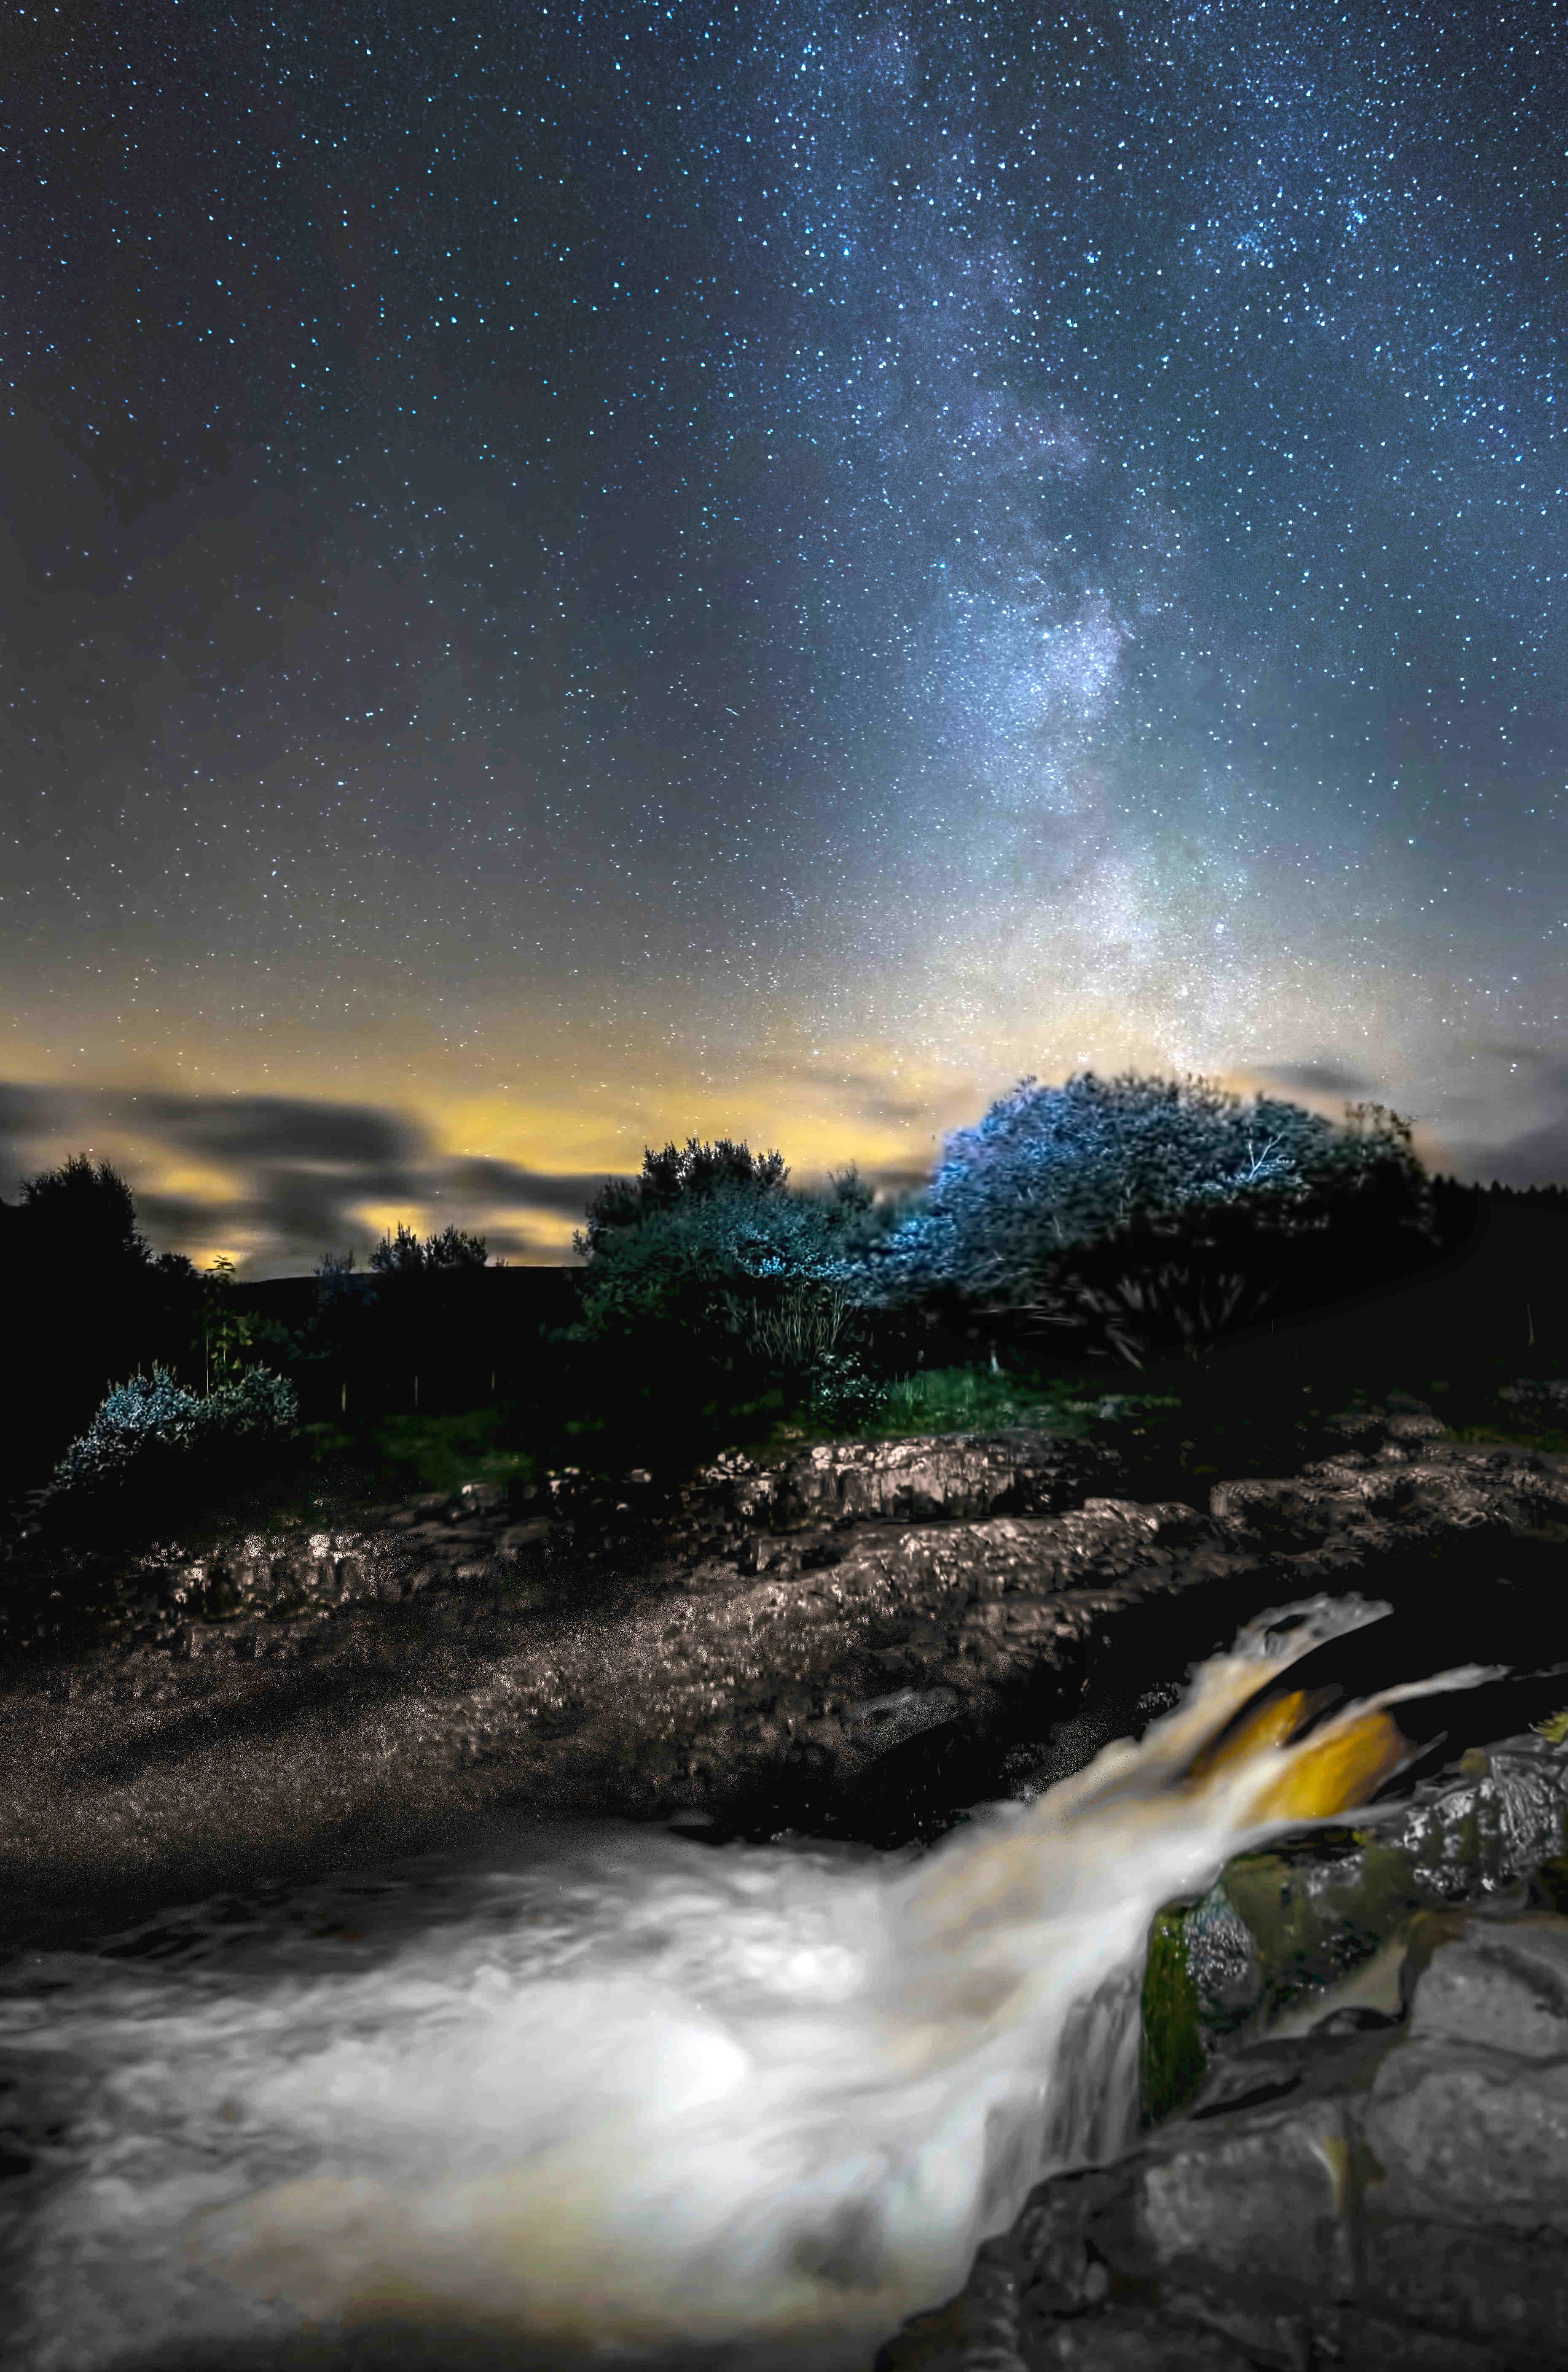
Dark Skies in Durham
Picture
Gary Lintern

Slide 8
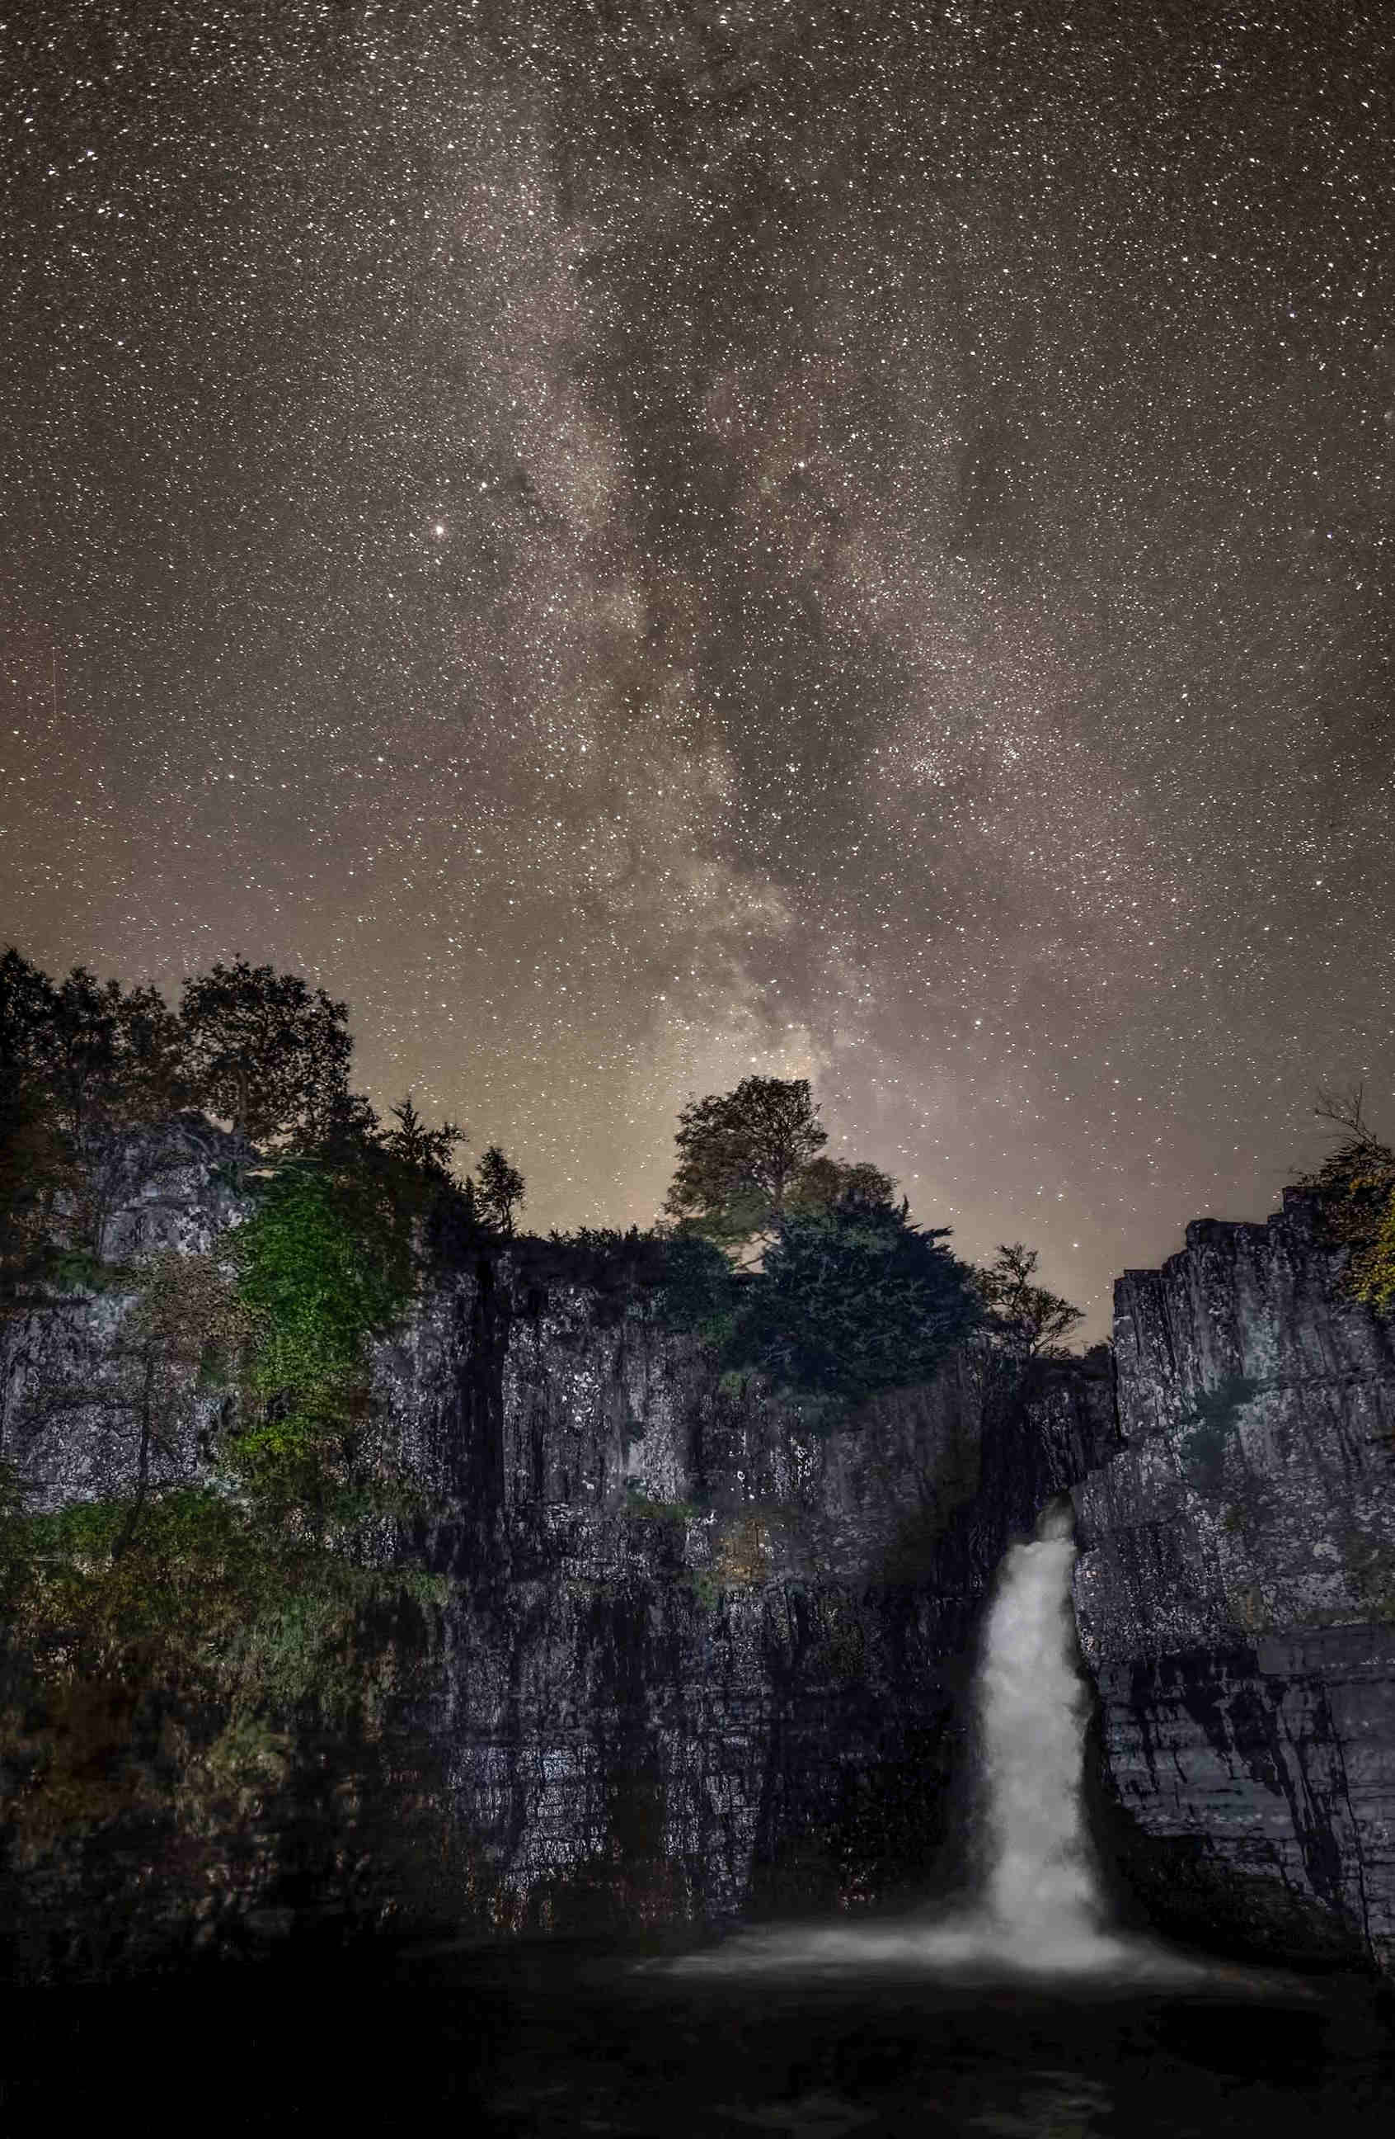
Dark Skies in Durham
Picture
Gary Lintern

Slide 9
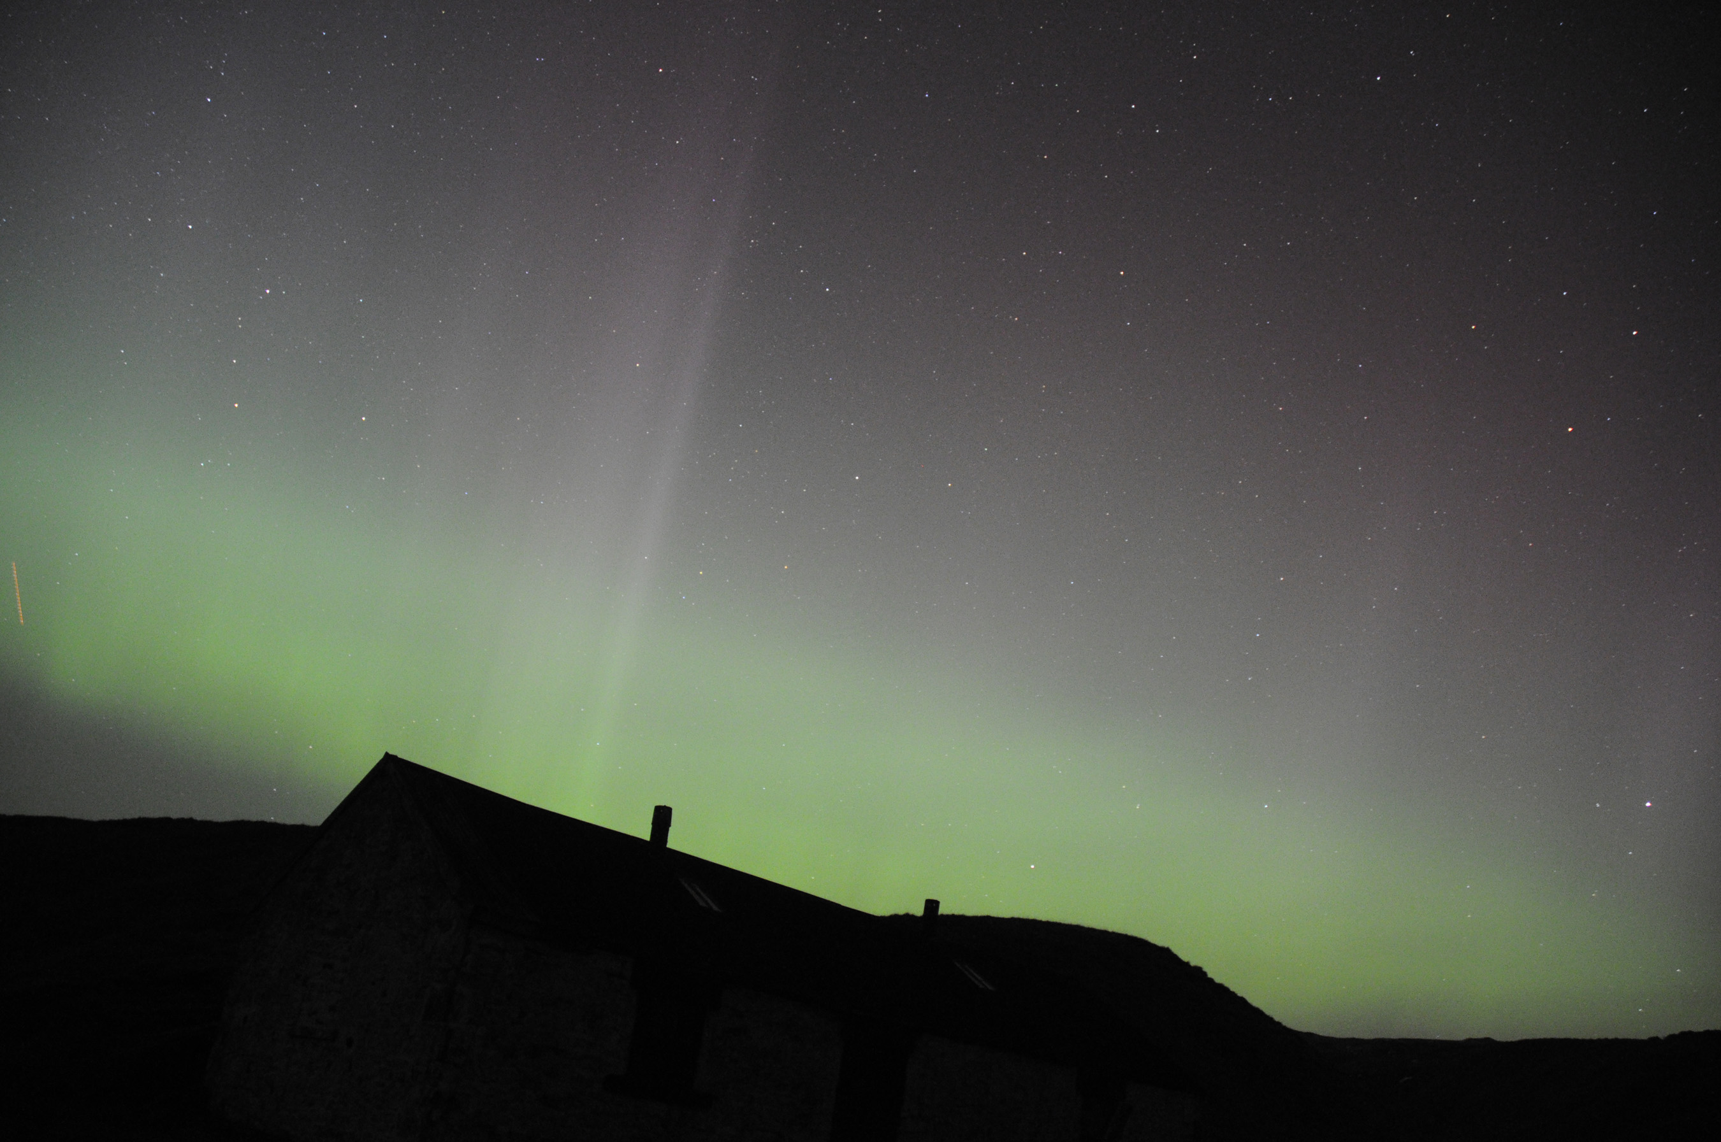
Dark Skies in Durham 3
Richard Darn
Picture
Richard Darn

Slide 10
Dark Sky Discovery Sites

Slide 11
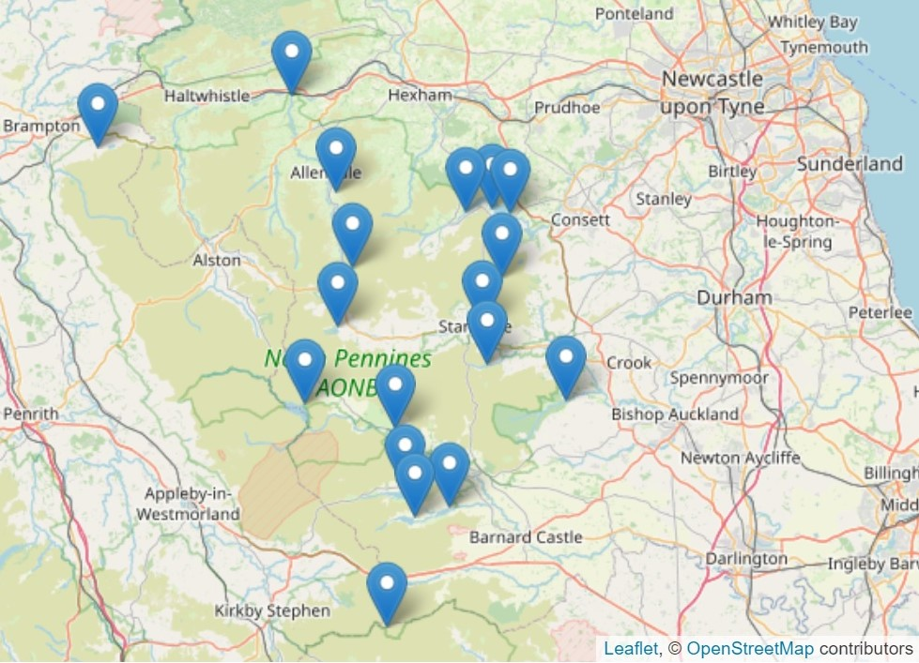
Dark Sky Discovery Sites in NPAONB
16 sites within North Pennines AONB
12 in County Durham

Slide 12
IDA Dark Sky Places in the UK​
Exmoor Dark Sky Reserve​
Northumberland Dark Sky Park​
Brecon Beacons Dark Sky Reserve​
Isle of Col Dark Sky Community​
Moffat Dark Sky Community​
Sark Dark Sky Community​
Galloway Forest Dark Sky Park
Davagh Forest (NI)​
Elan Valley Dark Sky Park, Wales​
Snowdonia Dark Sky Reserve​
South Downs Dark Sky Reserve​
Bodmin Dark Sky Landscape​
Tomintoul and Glenlivet – Cairngorms ​
Cranborne Chase AONB
North Ronaldsay (Orkney)
Yorkshire Dales National Park
North York Moors National Park

Slide 13
Astro Tourism

Slide 14
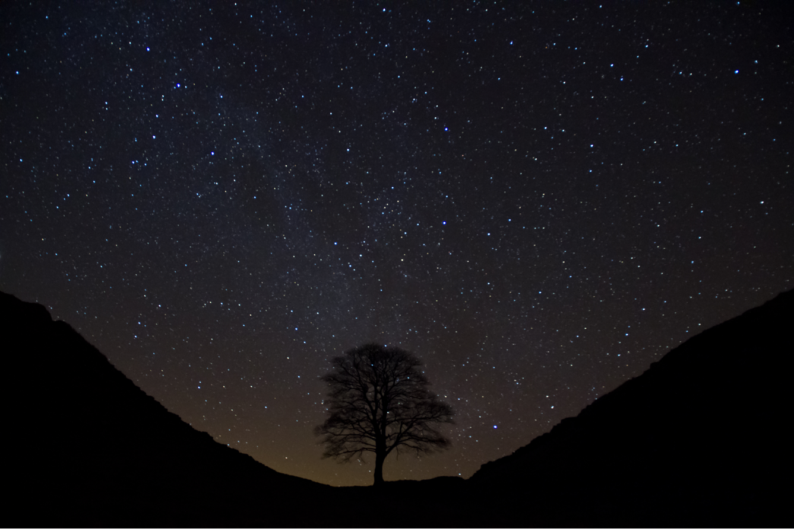
Dark skies tourism Northumberland ​
Worth £25 million per year
Supports 450 jobs

Slide 15
Case studies

Slide 16
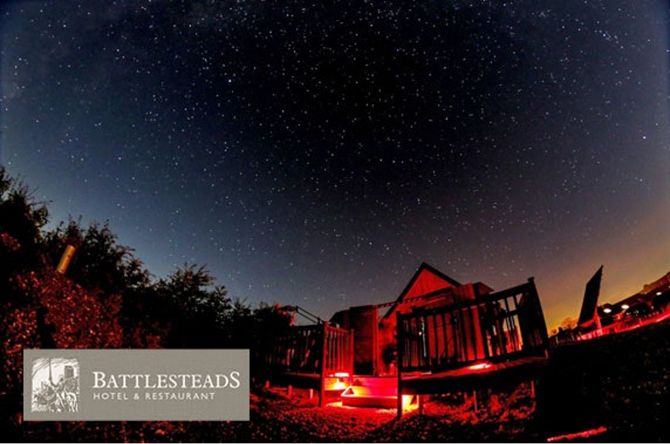
Battlesteads Hotel & Restaurant
Spent £100k building its own observatory.
Offers stargazing and accommodation packages.
Bookings contribute 15% to hotel income.

Slide 17
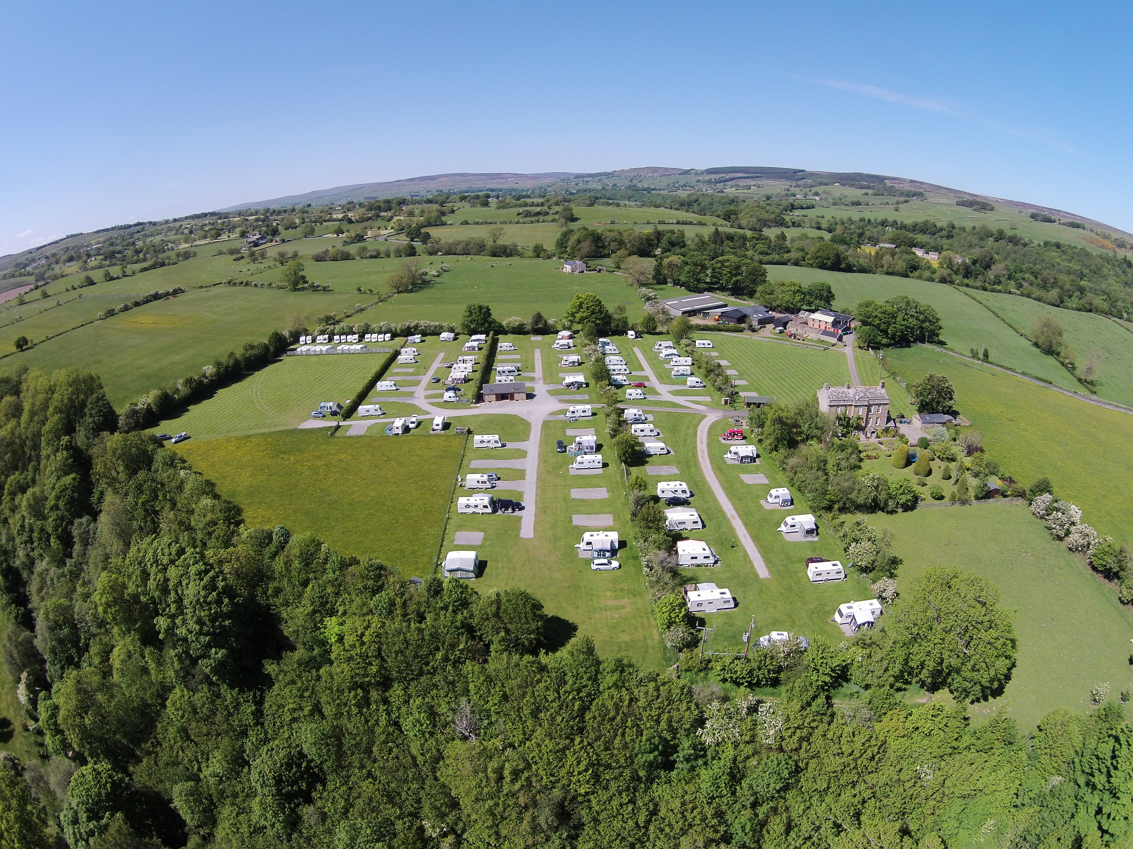
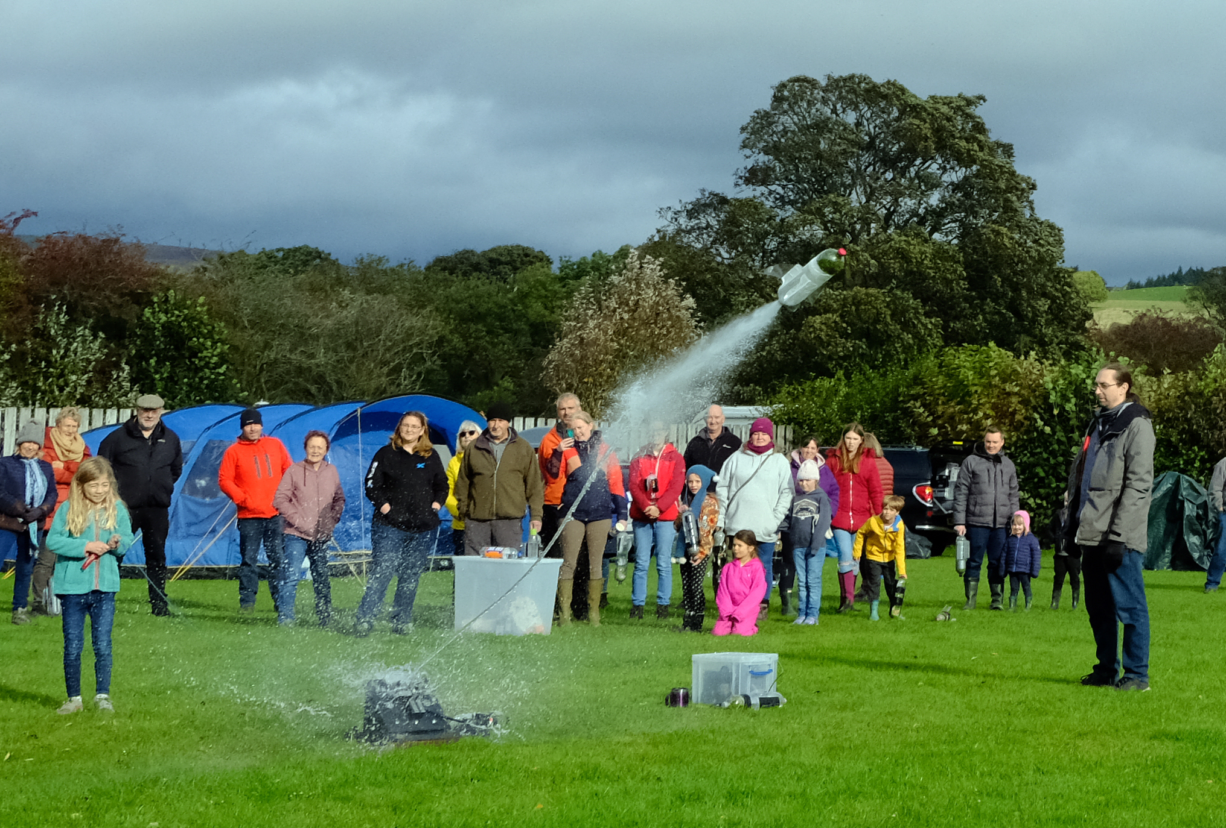
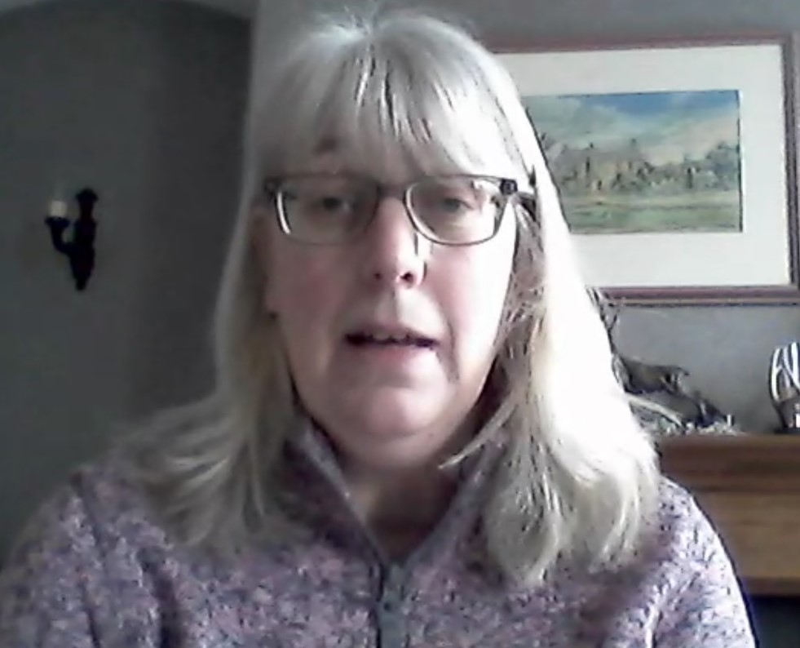
Doe Park
Attended dark skies workshop
Realised night sky was a big draw
Agreed to host AONB Star Camp
Worried about weather, but not a problem
Two days of activities, very accessible
Feedback very positive
Increased visitors considerably
30 more pitches each time than normal
for the time – could have been more

Slide 18
Marketing your
stargazing destination

Slide 19
Dark skies extends your season
Stargazing is a shoulder season activity from September to May
Something new to see each season
Autumn is the best time to see the Milky Way
Winter is great for sparkling star clusters and is when the sky
gets its very darkest
Spring allows us to see lots more distant galaxies

Slide 20
Who are your potential visitors?
Amateur astronomers who cherish dark skies
Novices with casual interest – families/couples/solo travellers

Slide 21
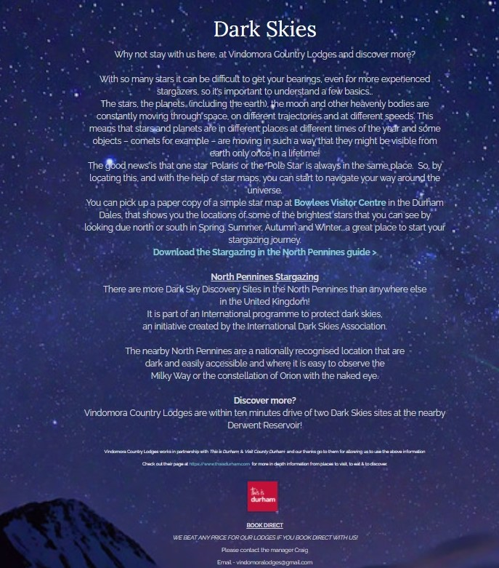
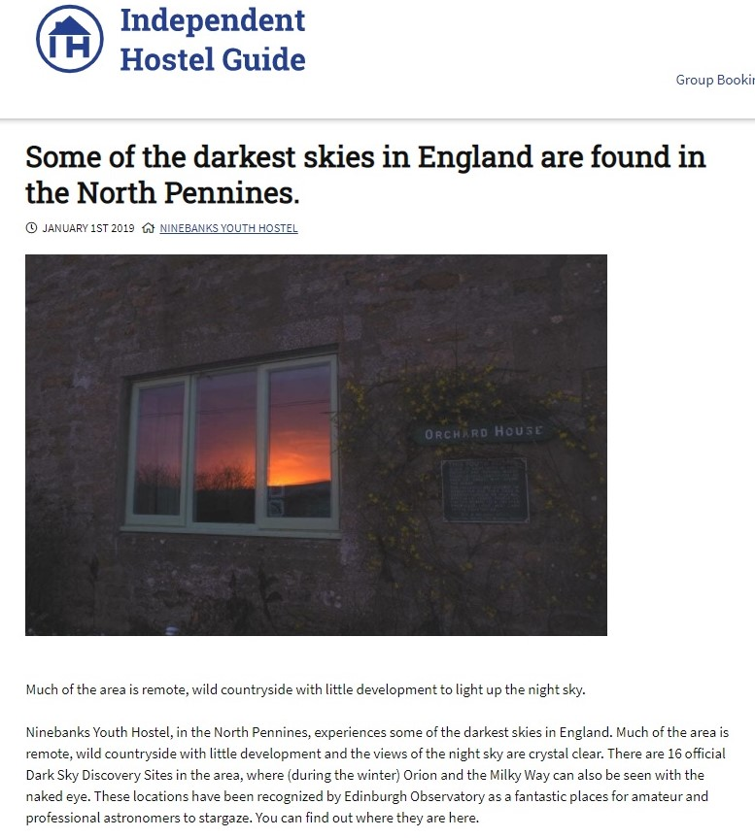
Post a stargazing page on your website
Featured under things to do or activities
Highlight how your property is suitable for stargazing or a gateway

Slide 22
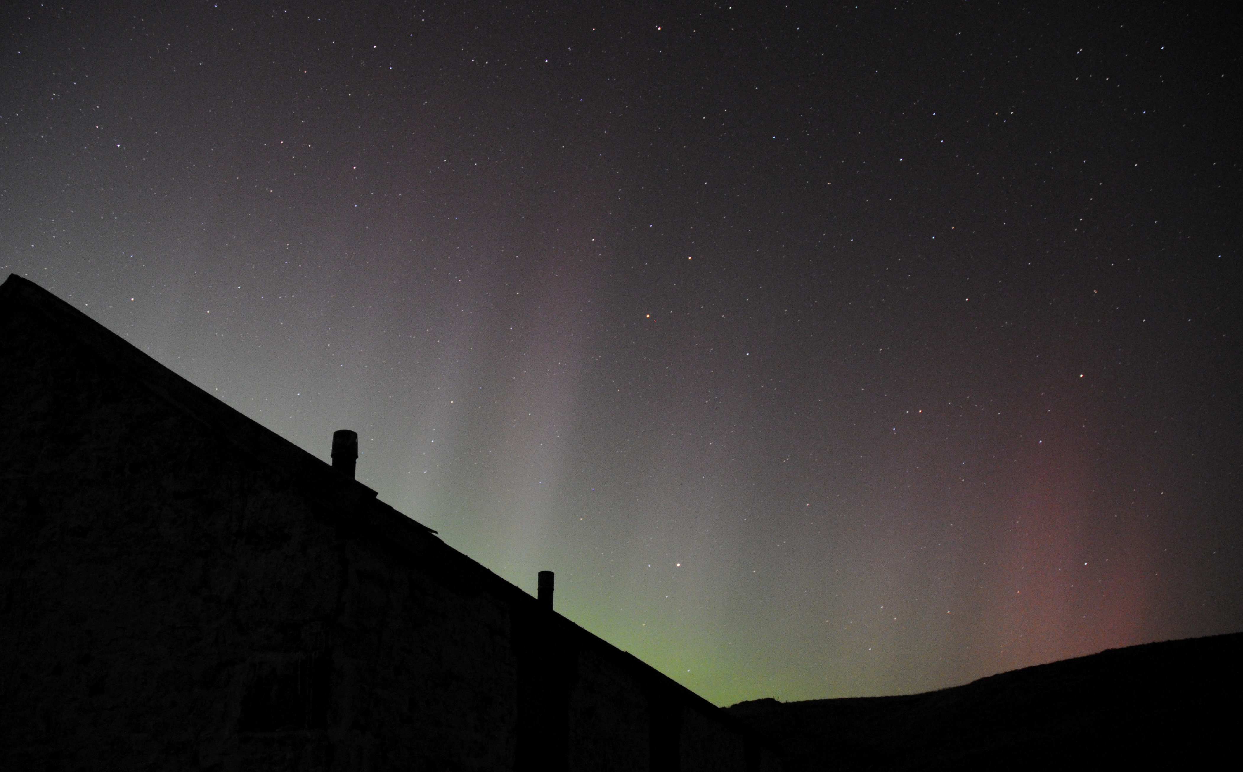
Use key messages:
not too wordy + images
Star quality!
The North Pennines has some of the nation’s starriest skies.
We see thousands of stars overhead compared with a handful from
towns and cities!
Glimpse the Milky Way in all its glory, along with sparkling star clusters
and even the elusive Northern Lights.
Our dark skies are also good for nocturnal wildlife like owls and moths.

Slide 23
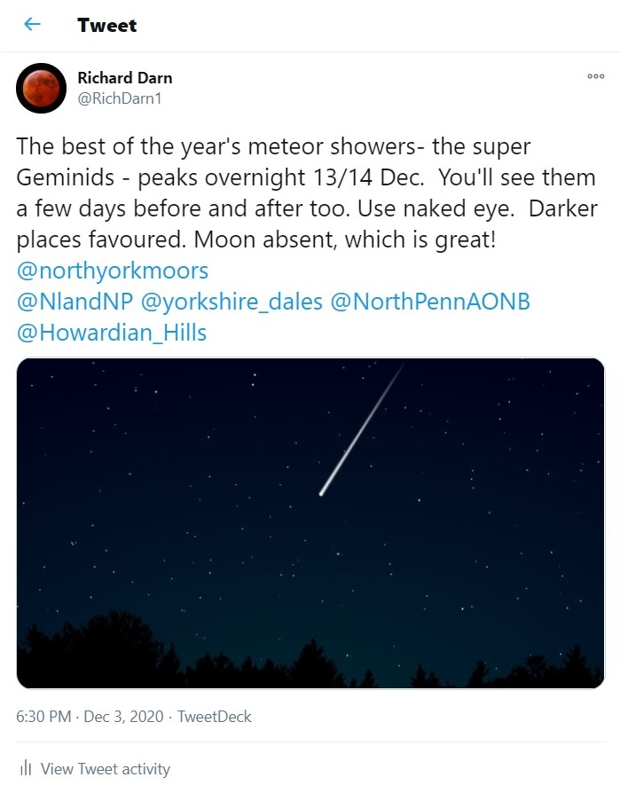
Use social media and
schedule regular posts/
retweets
Milky Way season (Sept onwards)
Meteor showers
Perseids meteor shower
(12 - 13 August)
Orionids meteor shower
(21 October)
Leonids meteor shower
(17 - 18 November)
Geminids meteor shower
(13 - 14 December)

Slide 24
Promotion
You are in (or very near) one of the
darkest areas of England
Don’t be shy
Celebrate it and promote it

Slide 25
Part two
Part Two

Slide 26
Simple steps to make yourself dark sky friendly
Simple steps to make
yourself dark sky friendly

Slide 27
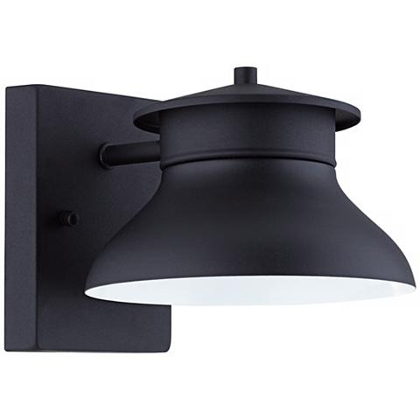
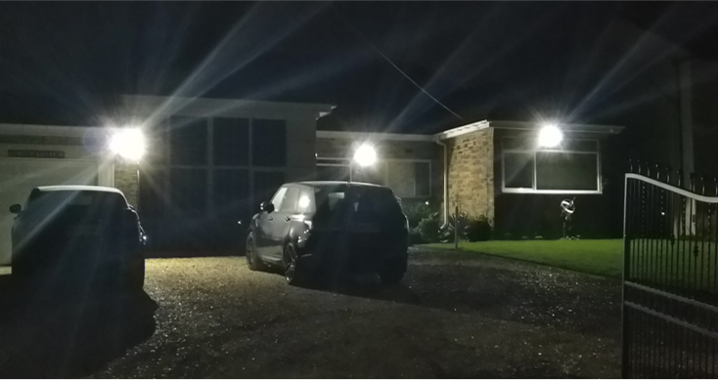
Lighting
Look again at your lighting
Create a dark area in your garden or on your land
Use lighting only where you need it and make it “Dark Sky Friendly”

Slide 28
Protecting the night sky

Slide 29
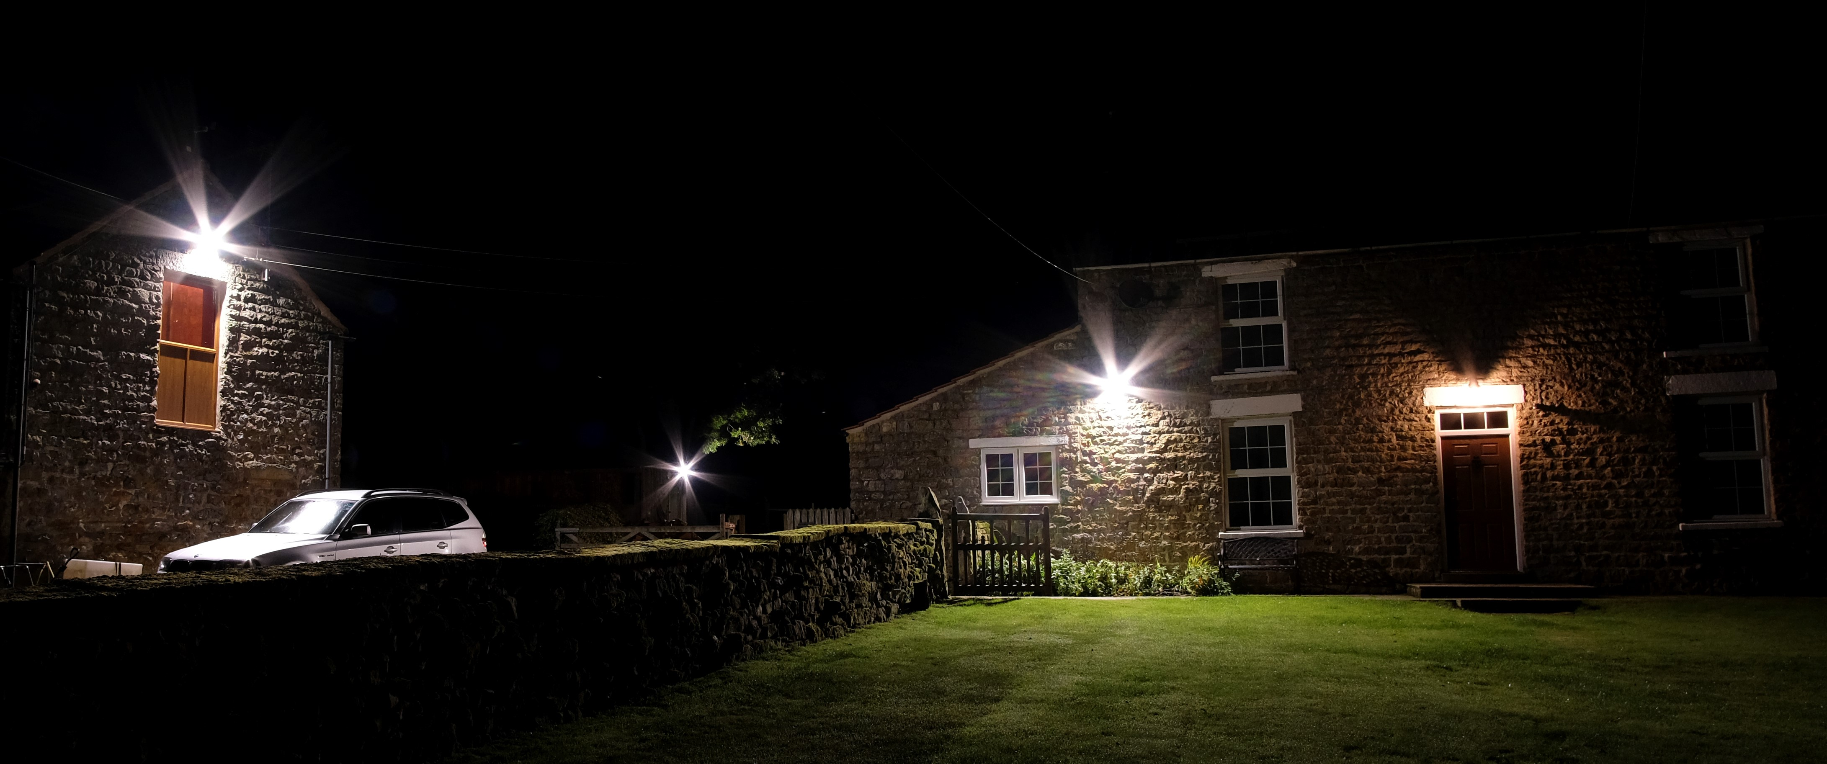
Dark sky lighting… before retrofit

Slide 30
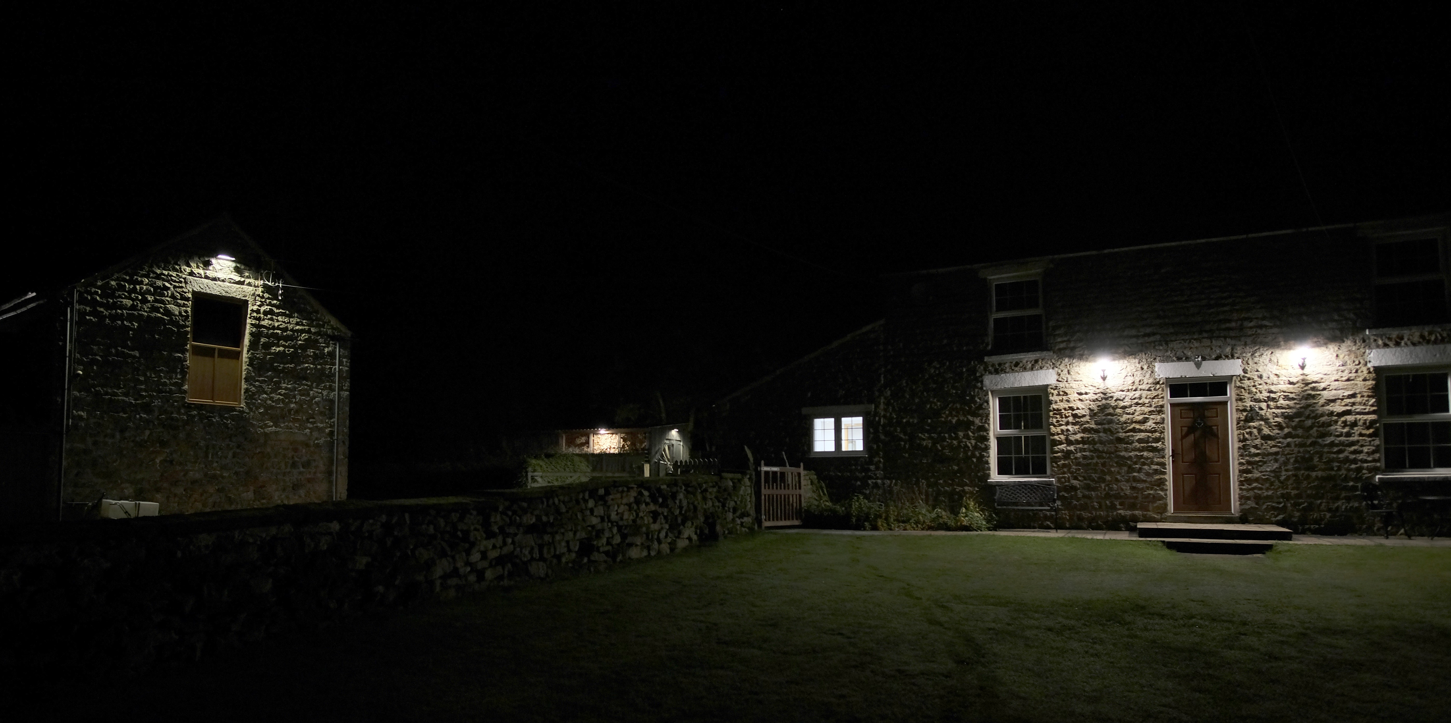
And after...

Slide 31
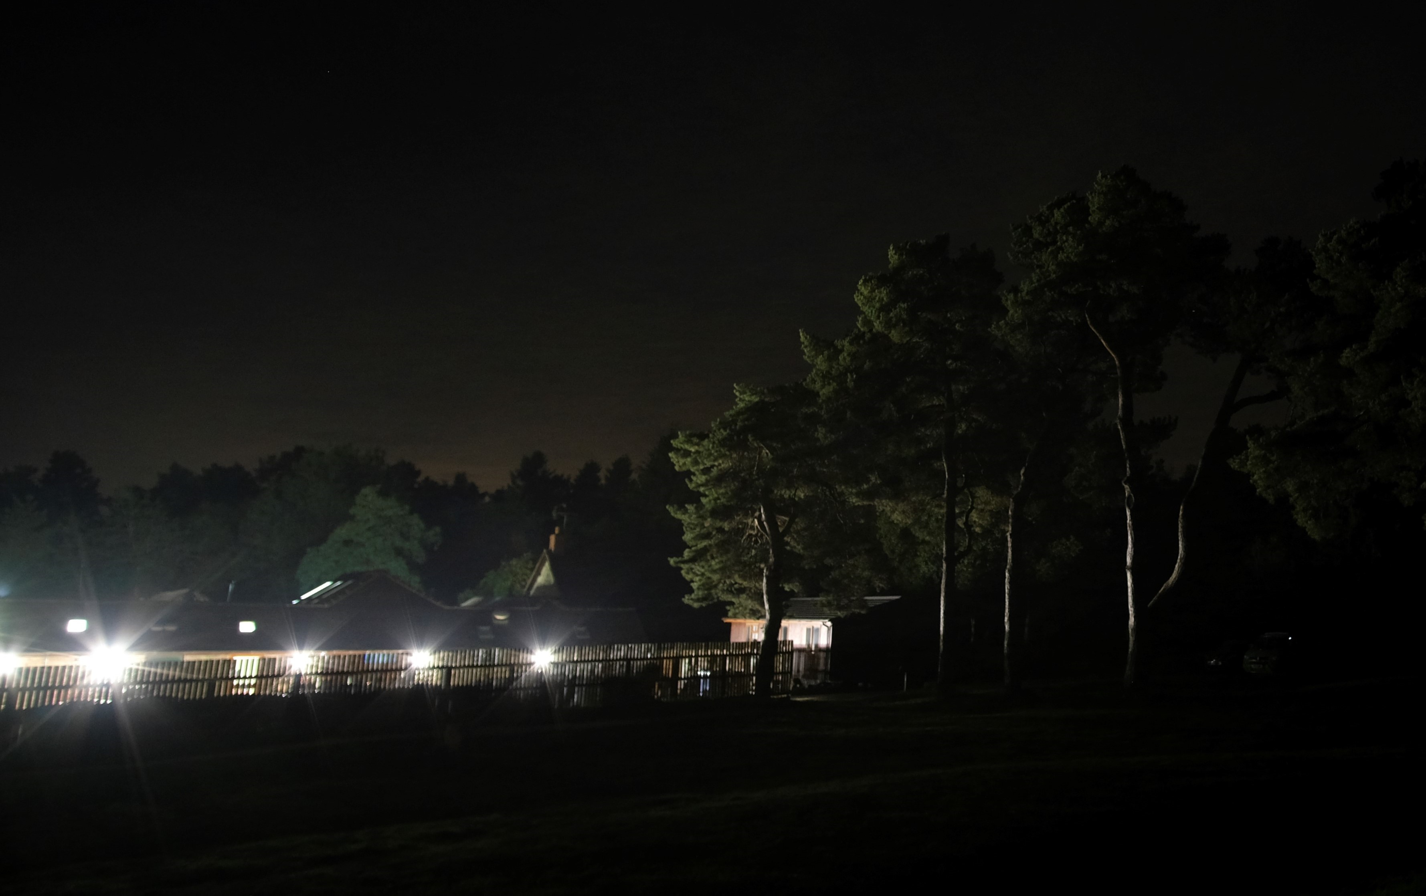
Dark sky Lighting

Slide 32
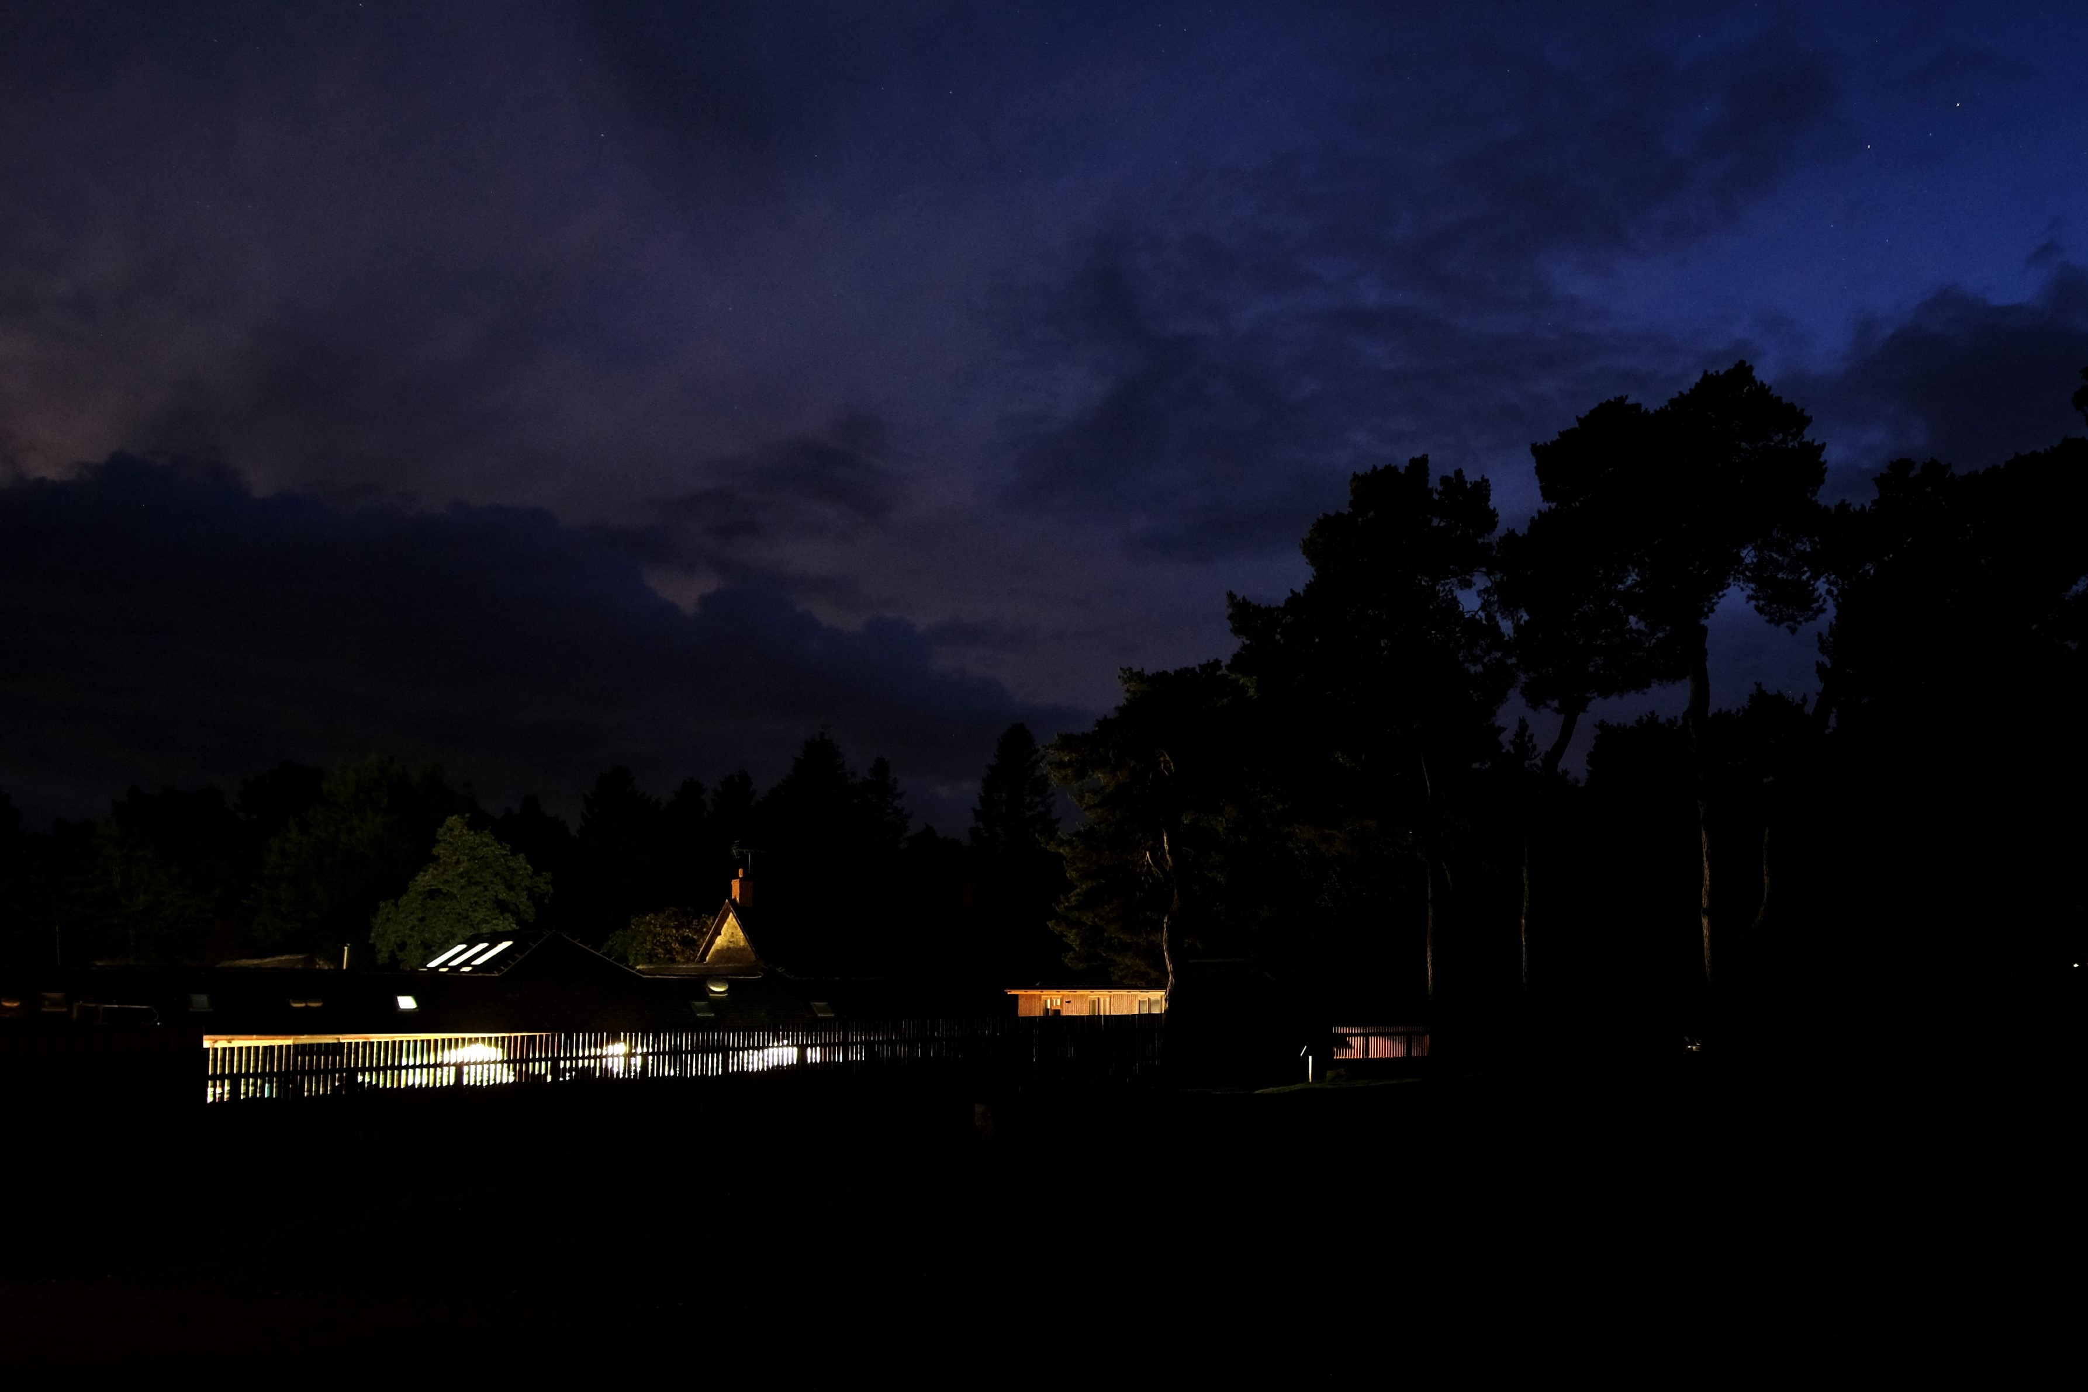
Dark Sky Lighting

Slide 33
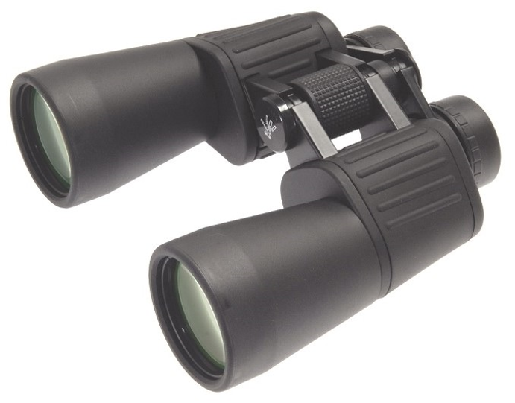
Provide basic equipment - Binoculars
Best sizes 10 x 50 and 7 x 50
Light, hand-held, easy to use
Wide field of view
Better than telescopes for unaided novices
Sweep the Milky Way, craters on the Moon, larger star clusters, brighter. comets, big galaxies, moons of Jupiter

Slide 34
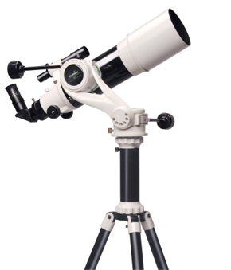
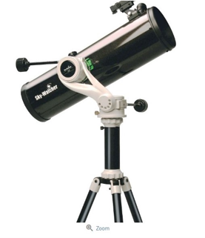
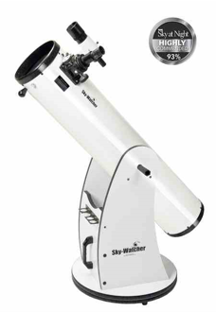
Telescopes
Telescopes
Better views of planets, star clusters etc
Narrower field of view
Keep it simple and portable - know your audience
Power of a telescope is aperture not magnification
Startravel 102 on AZ5 Delux, £330
SkyWatcher 130 on AZ5 Delux, £250
More advice and links:
https://darkskiesuk.org/blog-thoughts
https://gostargazing.co.uk/telescopes
Skyliner 200mm Dobsonian, £290

Slide 35
What else?
Folder of information for guests / stargazing leaflets
Red torches (preserves night vision)
Reclining chairs (excellent for meteor showers!)
Blankets and hats (people cool down quickly!)

Slide 36
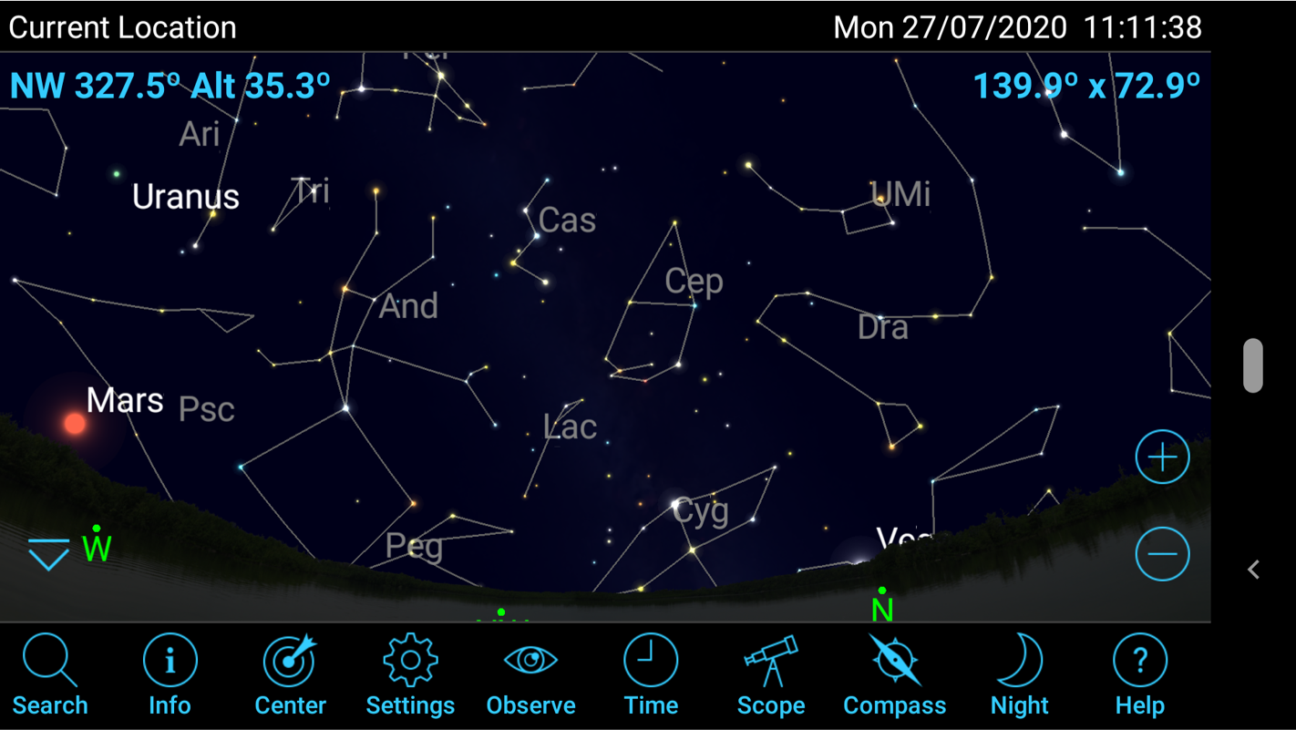
Apps
Sky Safari​
Google Skymap​
Meteor Shower Guide​
ISS Detector​
ISS Spotter​
Stellarium
Heavens Above​
Star Walk (iOS)​
Stellar Tour (iOS)
APT Darkness Clock

Slide 37
Finally - get involved
Become Dark Sky Friendly Business
Put a page up on your website
Put stargazing content on your social media
Buy couple of pairs of binoculars/red torches
Adjust your lighting if possible – help keep our skies dark
Promote the North Pennines Stargazing Festival

Slide 38
Dark Sky Friendly Durham

